Slide 1






Enhanced environmental protection inspection for efficient control of air quality monitoring and of all entities under obligation within system of greenhouse gas emission allowance trading, in order to achieve better quality of air in Republic of Croatia
This project is funded by the European Union

Slide 2



TOPIC 14: Delivering air quality data to EEA/EIONET
Energy research and Environmental Protection Institute

Slide 3

14.1 REPORTING TO EC AND EEA – GENERAL OBLIGATIONS
European Union IPA 2013 Programme for Croatia
Ordinance on mutual information exchange and reporting on air quality and obligations for implementation of Commission’s Decision 2011/850 / EU established the competent authority and framework for implementation of Commission’s Implementing Decision of 12 December 2011 on identifying the rules for Directives 2004/107/EZ i 2008/50/EC of the European Parliament and Council regarding mutual information exchange and reporting on air quality (2011/850/EU) that prescribes e-Reporting on air quality.
The ordinance prescribes the tasks of the Agency and other bodies in relation to the method, deadlines, content and data format and the way of data collection for mutual exchange of information and reporting on air quality assessment and management.
Pursuant to the ordinance, the competent authority for the Implementation of the Commission’s Decision 2011/850 / EU is the Croatian Environment and Nature Agency, HAOP (ex AZO).
Institut za energetiku i zaštitu okoliša
Energy Research and Environmental Protection Institute

Slide 4
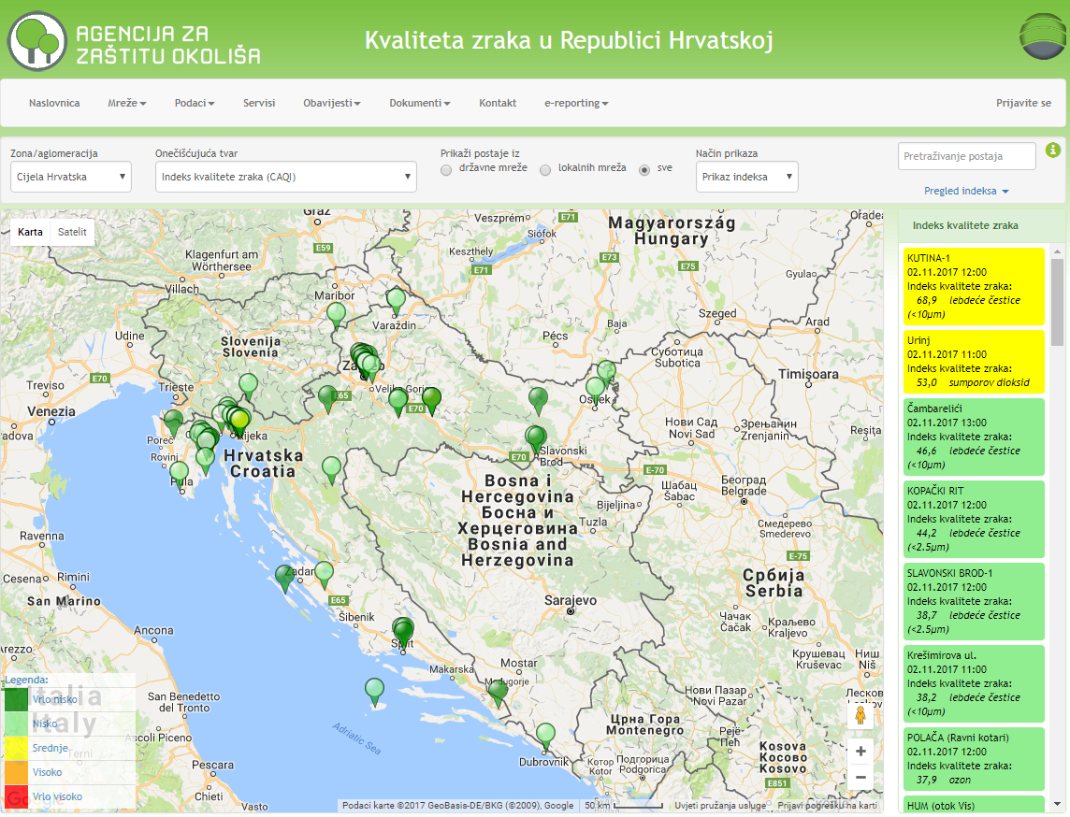
14.1 REPORTING TO EC AND EEA – GENERAL OBLIGATIONS
European Union IPA 2013 Programme for Croatia
To meet the goals of e-Reporting it is necessary to collect in the database and properly compile all the air quality data needed for exchange.
For this purpose, in 2014 the Agency developed and established the portal "Air Quality in the Republic of Croatia".
The Portal is located on the Agency's website and contains all data on concentrations of pollutants in the air measured in the whole territory of the Republic of Croatia.
http://iszz.azo.hr/iskzl/index.html
Institut za energetiku i zaštitu okoliša
Energy Research and Environmental Protection Institute

Slide 5
14.1 REPORTING TO EC AND EEA – GENERAL OBLIGATIONS
European Union IPA 2013 Programme for Croatia
The system (Portal) allows for submission of air quality information in a standardized data exchange (.xml) format to the repository of the European Commission and European Environment Agency in accordance with requirements of CAFE and INSPIRE Directives.
The portal fully meets the given criteria and enables complete delivery of all air quality data to the EC.
Thus the official air quality data (B - G) were submitted for the first time in the EC data repository in 2014 for the year 2013.
All data shall be submitted to the air protection information system in electronic form using the formats and protocols published by the Agency on its web site.
Institut za energetiku i zaštitu okoliša
Energy Research and Environmental Protection Institute

Slide 6
14.1 REPORTING TO EC AND EEA – GENERAL OBLIGATIONS
European Union IPA 2013 Programme for Croatia
For information exchange and reporting on air quality assessment and management one uses data on concentrations of pollutants obtained by measurements on measurement points specified in Articles 4 to 6 of the Regulation on the establishment of a list of measurement points for monitoring concentration of certain pollutants in the air and locations of monitoring stations in the national network for permanent air quality Monitoring (Official Gazette, No. 65/16).
In addition to concentrations of pollutants obtained through measurements at permanent measurement points, for reporting one can also use data obtained by indicative measurements, modeling and objective estimation techniques.
Institut za energetiku i zaštitu okoliša
Energy Research and Environmental Protection Institute

Slide 7
14.1 REPORTING TO EC AND EEA – GENERAL OBLIGATIONS
European Union IPA 2013 Programme for Croatia
Data are delivered to CDR (Central Data Repository)
http://cdr.eionet.europa.eu/hr/eu/aqd
That can also be accessed by Europen Air Quality Portal
http://eeadmz1-cws-wp-air.azurewebsites.net/
Officially published information on air quality are available on EEA web site.
https://www.eea.europa.eu/themes/air/dc
Comments and suggestions on the above mentioned web site shall be addressed to AQ IPR helpdesk AQ IPR helpdesk
Institut za energetiku i zaštitu okoliša
Energy Research and Environmental Protection Institute

Slide 8
14.1 REPORTING TO EC AND EEA – GENERAL OBLIGATIONS
European Union IPA 2013 Programme for Croatia
European Air Quality Portal contains technical details and services that facilitate reporting on official air quality information to EU member states and other EEA partner countries.
http://eeadmz1-cws-wp-air.azurewebsites.net/
The data are submitted in accordance with Directives 2004/107 / EC and 2008/50 / EC of the European Parliament and of the Council, and the rules for exchange are laid down in
Commission’s Implementing Decision 2011/850 / EU.
Portal je razvila i održava ga Europska agencija za okoliš (EEA).
The portal has been developed and maintained by the European Environment Agency (EEA).
Institut za energetiku i zaštitu okoliša
Energy Research and Environmental Protection Institute

Slide 9
14.1 REPORTING TO EC AND EEA – GENERAL OBLIGATIONS
European Union IPA 2013 Programme for Croatia
Data to be submitted to EC/EEA are:
Preliminary data
Preliminary data on zones and agglomerations (Preliminary B) – those are the data on limits and types of zones and agglomerations that have been established and in which the air quality assessment and management will be carried out in the following calendar year - shall be submitted no later than 31 December each year for the next calendar year
Preliminary Data on Assessment System (Preliminary C) – those are the data on the expected levels of pollution in relation to the upper and lower thresholds and how the air quality will be monitored in the next calendar year for each pollutant within a zone and agglomeration - shall be delivered no later than 31 December each year for the following calendar year
Institut za energetiku i zaštitu okoliša
Energy Research and Environmental Protection Institute

Slide 10
14.1 REPORTING TO EC AND EEA – GENERAL OBLIGATIONS
European Union IPA 2013 Programme for Croatia
Official data (for previous calendar year):
Zone and agglomeration data (B) – those are the data on limits and types of zones and agglomerations in which the air quality assessment was carried out in the previous calendar year – they are submitted no later than September 30 each year for the previous calendar year
The assessment system dana (C) – those are the data on levels of pollution in relation to the upper and lower estimate thresholds and the method of air quality monitoring in the previous year for each pollutant within a given zone and agglomeration - to be submitted by September 30 at the latest for the previous calendar year
Institut za energetiku i zaštitu okoliša
Energy Research and Environmental Protection Institute

Slide 11
14.1 REPORTING TO EC AND EEA – GENERAL OBLIGATIONS
European Union IPA 2013 Programme for Croatia
Official data (for previous calendar year):
Network and station data (metadata) (D) – those are the data on measurement methods at constant measuerement points, their quality and traceability, and the applied indicative measurements – they are submitted no later than September 30 each year for the previous calendar year
Data on applied modeling techniques and / or objective estimates (metadata) (D1b) - those are the data of applied modeling methods and objective evaluation techniques – they are submitted no later than September 30 each year for the previous calendar year
Institut za energetiku i zaštitu okoliša
Energy Research and Environmental Protection Institute

Slide 12
14.1 REPORTING TO EC AND EEA – GENERAL OBLIGATIONS
European Union IPA 2013 Programme for Croatia
Official data (for previous calendar year):
Original and validated data (E)
validated measurement data (E1a) – they are submitted no later than September 30 each year for the previous calendar year
modeling data (E1b) - are submitted no later than September 30 each year for the previous calendar year (if any)
modeling data (E1b) – they are submitted no later than September 30 each year for the previous calendar year (if any)
Up TO Date (UTD) metering data (E2a) – they are delivered continuously every hour (sometimes Near Real Time NRT data)
Institut za energetiku i zaštitu okoliša
Energy Research and Environmental Protection Institute

Slide 13
14.1 REPORTING TO EC AND EEA – GENERAL OBLIGATIONS
European Union IPA 2013 Programme for Croatia
Official data (for previous calendar year):
Statistical data (F) - not submitted but must be calculated in order to be able to determine exceedances and give an assessment
The assessment of pollution with exceedance of limit and target values (G) – those are the data on the achievement of environmental objectives (comparison with limit or target values) – they are submitted no later than September 30 each year for the previous calendar year
Institut za energetiku i zaštitu okoliša
Energy Research and Environmental Protection Institute

Slide 14
14.1 REPORTING TO EC AND EEA – GENERAL OBLIGATIONS
European Union IPA 2013 Programme for Croatia
Submitted information on action plans:
Information on action plans for improving air quality (H) - this is general information on action plans: plan name, year of first exceedance, responsible authority, included pollutants, plan adoption date, implementation time schedule ...
Source Distribution Information (I) - This is information about source apportionment, ie. contribution to pollution: local, regional, urban ...
Institut za energetiku i zaštitu okoliša
Energy Research and Environmental Protection Institute

Slide 15
14.1 REPORTING TO EC AND EEA – GENERAL OBLIGATIONS
European Union IPA 2013 Programme for Croatia
Submitted information on action plans :
Information on scenario for the year of achievement (J) - this is information about the initial and projection scenario for the year of reaching the limit value. The initial scenario is without taking measures, and the projection scenario is with the measures taken.
Information on measures to improve air quality (K) - information on measures taken to achieve limit and / or target values: type of measure, time period of measure, sectors and areas which the measure affects, emission reduction due to measure implementation and expected influence on concentrations.
Institut za energetiku i zaštitu okoliša
Energy Research and Environmental Protection Institute

Slide 16
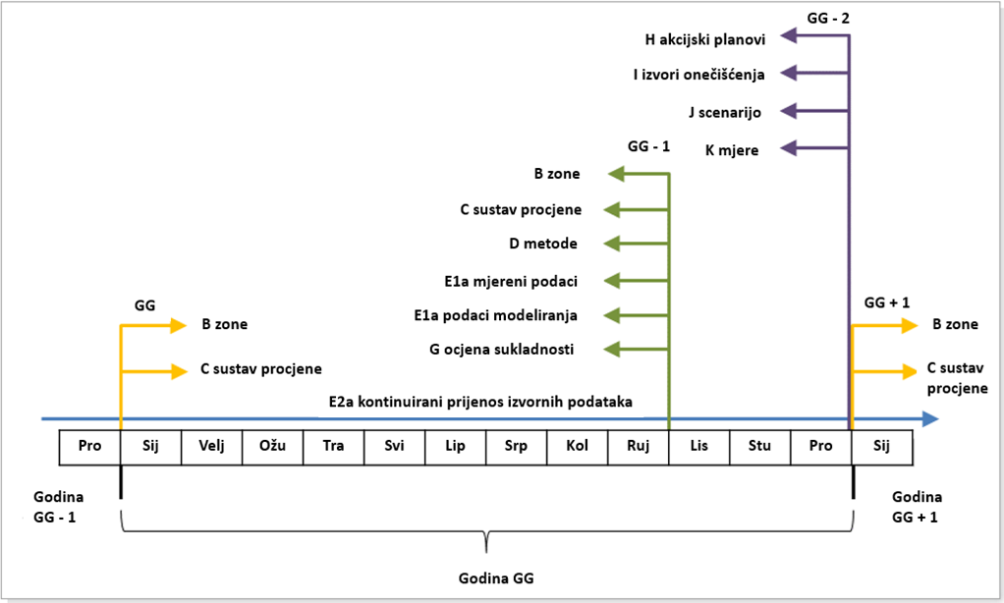
14.1 REPORTING TO EC AND EEA – GENERAL OBLIGATIONS
European Union IPA 2013 Programme for Croatia
Reporting obligations– timeline
Institut za energetiku i zaštitu okoliša
Energy Research and Environmental Protection Institute

Slide 17
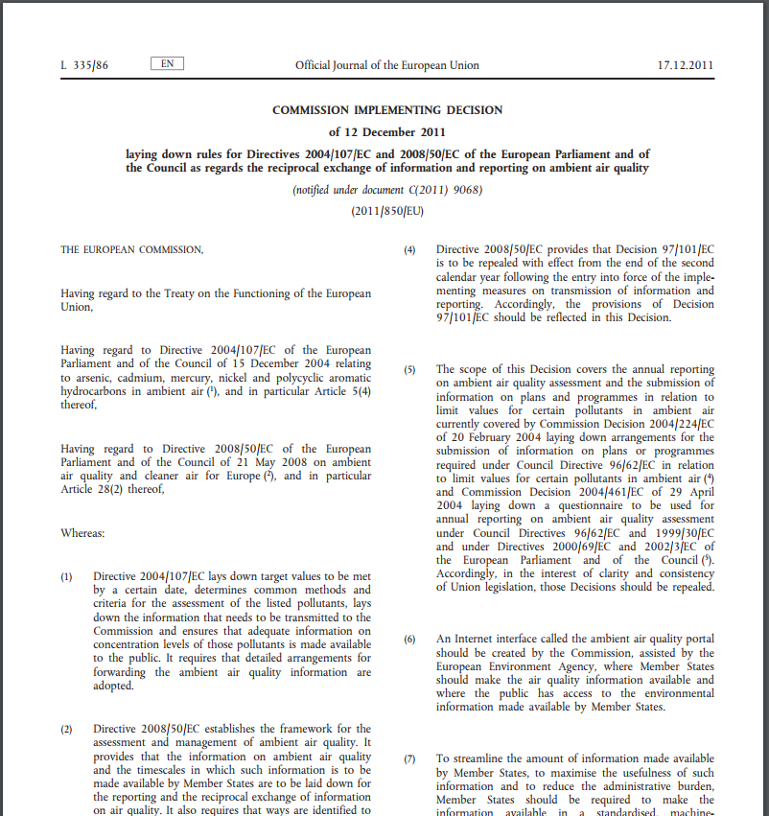
14.2 EUROPEAN COMMISSION IMPLEMENTING DECISION 2011/850/EU (IPR)
European Union IPA 2013 Programme for Croatia
European Commission passed the Implementing Decision on 12th December 2011 2011/850/EU
on the establishment of rules for the implementation of Directives 2004/107 / EC and 2008/50 / EC of the European Parliament and of the Council on the reporting by the Member States of the European Union on air quality assessment and management and mutual exchange of information about networks and stations and air quality measurements
http://eur-lex.europa.eu/LexUriServ/LexUriServ.do?uri=OJ:L:2011:335:0086:0106:EN:PDF
Institut za energetiku i zaštitu okoliša
Energy Research and Environmental Protection Institute

Slide 18
14.2 EUROPEAN COMMISSION IMPLEMENTING DECISION 2011/850/EU (IPR)
European Union IPA 2013 Programme for Croatia
Decision 2011/850 / EU also known as Implementing Provisions on Reporting (IPR) has replaced three recent air quality reporting decisions:
Council Decision 97/101 / EC establishing mutual exchange of information and data from networks and individual stations for measurement of air pollution,
Commission Decision 2004/224 / EC on defining procedures for submission of information on plans or programs in relation to the limit values of certain pollutants in the air and
Commission Decision 2004/461 / EC on the establishment of a questionnaire for the submission of an annual air quality assessment report.
Decision 2011/850/EU, has been implemented (came into effect) from 1st January 2014. In other words, it is applied to information/data on air quality collected by member states since January 2013.
Institut za energetiku i zaštitu okoliša
Energy Research and Environmental Protection Institute

Slide 19
14.2 EUROPEAN COMMISSION IMPLEMENTING DECISION 2011/850/EU (IPR)
European Union IPA 2013 Programme for Croatia
IPR prescribed a new reporting mechanism, e-reporting, more recent and more modern than former reporting methods (DEM, AQ Questionnaire, NRT-data, Plans & Programs):
For the purpose of rationalizing the amount of information being disclosed, increasing the benefits of such information and reducing administrative burden, information must be prepared and delivered in a standardized machine-readable form (XML format) and aligned with the requirements of Directive 2007/2 / EC on the Establishment of Spatial Information Infrastructure in the European Community (INSPIRE).
Information is delivered to the EIONET Central Data Repository (CDR), accessible through the AQ Portal established by the EC, which is maintained and managed by the European Environment Agency (EEA). The portal has all the news, guidelines and instructions related to e-reporting.
Institut za energetiku i zaštitu okoliša
Energy Research and Environmental Protection Institute

Slide 20
14.2 EUROPEAN COMMISSION IMPLEMENTING DECISION 2011/850/EU (IPR)
European Union IPA 2013 Programme for Croatia
Competent authority for implementation of the Commission Decision 2011/850 / EU is the Agency that conducts following activities for purposes of Decision implementation:
– delivers the information used for the mutual exchange of information and reporting, within the prescribed deadlines, on behalf of the Republic of Croatia in the data repository, established by the European Commission with the assistance of the European Environment Agency
– In the case of updating the information, it explains the differences between the updated and original information and the reasons for the update
– informs the European Commission of the responsible persons
– publishes the European Commission's Guidelines for mutual information exchange and air quality reporting on its web sites
Institut za energetiku i zaštitu okoliša
Energy Research and Environmental Protection Institute

Slide 21
14.3 PRELIMINARY DATA SUBMISSION
European Union IPA 2013 Programme for Croatia
As preliminary data in EC / EEA, data B and C are submitted:
Preliminary data on zones and agglomerations (B) – those are data on limits and types of zones and agglomerations that have been established and in which the air quality assessment and management will be carried out in the following calendar year - shall be submitted by 31 December each year for the following calendar year
Preliminary data on the assessment system (C) – those are data on expected levels of pollution in relation to the upper and lower thresholds and how the air quality will be monitored in the next calendar year for each pollutant within a given zone and agglomeration - delivered not later than 31 December each year for the following calendar year
-
Institut za energetiku i zaštitu okoliša
Energy Research and Environmental Protection Institute

Slide 22
14.3 PRELIMINARY DATA SUBMISSION
European Union IPA 2013 Programme for Croatia
Article 7 of Decision 2011/850 / EU states that Member States will make available information on the assessment system to be applied for each zone / agglomeration and pollutant in the following calendar year.
The objective of the assessment system is to compare pollution levels with environmental objectives (limit and target values) and based on these levels to establish a proportional regime or assessment system for the purpose of future air quality management.
The assessment system (regime) may include different types of estimates:
Fixed measurements
Indicative measurements
Modelling
Objective assessment
or their combination
The choice of assessment type will depend on the observed pollution levels of in relation to the estimation thresholds
Institut za energetiku i zaštitu okoliša
Energy Research and Environmental Protection Institute

Slide 23
14.3 PRELIMINARY DATA SUBMISSION
European Union IPA 2013 Programme for Croatia
Assessment system options allowed on the basis of preliminary estimates of pollutant levels
Pollutant | Pollution level | Observed period | Assessment system (regime)
SO₂, NO₂, NO_{x}, PM₁₀, PM_{2.5}, Pb, C₆H₆, CO As, Cd, Ni, BaP | Pollution level> UET | At least three years from previous five years | Fixed measurements, possibly supplemented by modeling techniques and / or indicative measurements, will be used.
SO₂, NO₂, NO_{x}, PM₁₀, PM_{2.5}, Pb, C₆H₆, CO As, Cd, Ni, BaP | Pollution level≤ UET and > LET | At least three years from previous five years | Fixed measurements can be combined with modeling techniques and / or indicative measurements.
SO₂, NO₂, NO_{x}, PM₁₀, PM_{2.5}, Pb, C₆H₆, CO As, Cd, Ni, BaP | Pollution level≤ LET | At least three years from previous five years | Modeling techniques or objective assessment techniques are sufficient.
O₃ | Pollution level> LG | Any of previous five years | Fixed measurements, possibly supplemented by modeling techniques and / or indicative measurements, will be used.
UET: upper estimate threshold; LET: lower estimate threshold; LG: long-.term goal
Institut za energetiku i zaštitu okoliša
Energy Research and Environmental Protection Institute

Slide 24
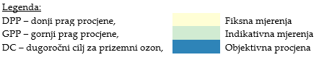
14.3 PRELIMINARY DATA SUBMISSION
European Union IPA 2013 Programme for Croatia
The levels of pollution are assessed against the upper and lower thresholds of the assessment and the method by which the assessment will be given.
The data are similar to the data for official delivery (data C from September for the previous year) - they need to be updated due to e.g. introducing a new measurement point on a new or already existing station - in that case, updated metadata (data D) should be delivered so that also UTD data (from new measurement points) can be sent.
Institut za energetiku i zaštitu okoliša
Energy Research and Environmental Protection Institute

Slide 25
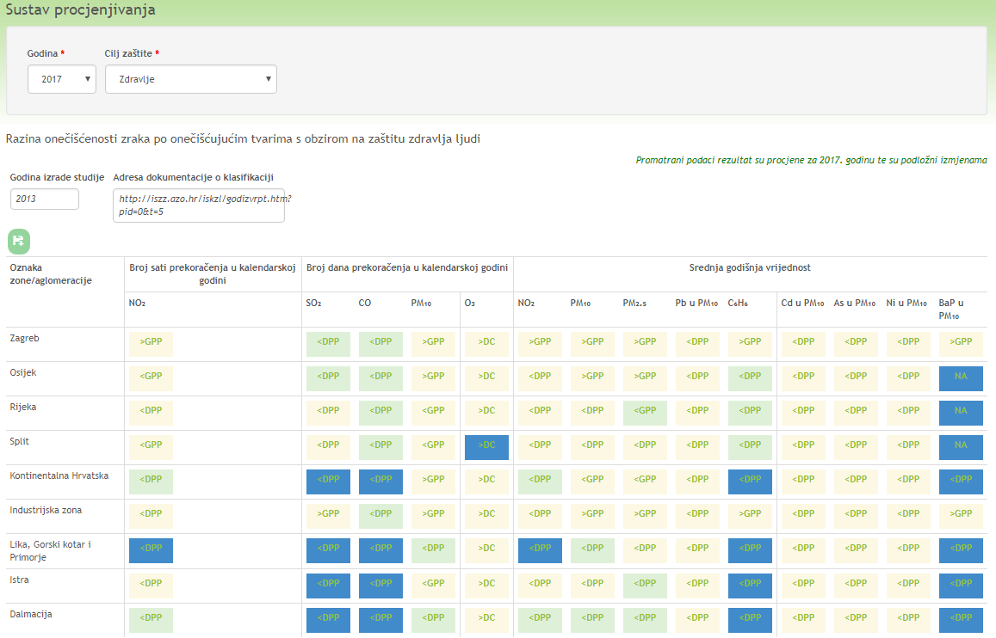
14.3 PRELIMINARY DATA SUBMISSION
European Union IPA 2013 Programme for Croatia
On the HAOP portal Air quality in the Republic of Croatia is marked with: Observed data are the result of the estimate for the following year and are subject to modifications
Institut za energetiku i zaštitu okoliša
Energy Research and Environmental Protection Institute

Slide 26
14.4 OFFICIAL DATA SUBMISSION
European Union IPA 2013 Programme for Croatia
Official air quality data to be submitted no later than 30 September each year for the previous calendar year:
Zone and Agglomeration Data (B)
Assessment System Data (C)
Network and Station Data (metadata) (D)
Data on applied modeling techniques and / or objective estimates (metadata) (D1b)
validated measurement data (E1a)
modeling data (E1b) (if any)
Pollution assessment with exceedance of limit values and target values (G)
Ocjena onečišćenosti sa prekoračenjima graničnih i ciljnih vrijednosti (G)
Institut za energetiku i zaštitu okoliša
Energy Research and Environmental Protection Institute

Slide 27
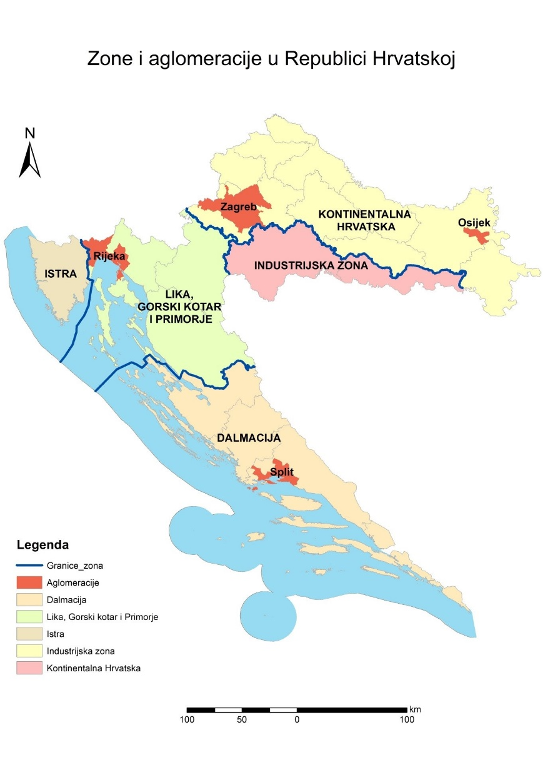
14.4 OFFICIAL DATA SUBMISSION
European Union IPA 2013 Programme for Croatia
Data on zones and agglomerations (B)
– data on limits and types of zones and agglomerations in which the air quality assessment was carried out in the previous calendar year
Institut za energetiku i zaštitu okoliša
Energy Research and Environmental Protection Institute

Slide 28
14.4 OFFICIAL DATA SUBMISSION
European Union IPA 2013 Programme for Croatia
Data on Assessment System (C) - Pollution Levels in relation to the upper and lower assessment thresholds and the method of air quality monitoring in the previous year for each pollutant within a given zone and agglomeration
Institut za energetiku i zaštitu okoliša
Energy Research and Environmental Protection Institute

Slide 29
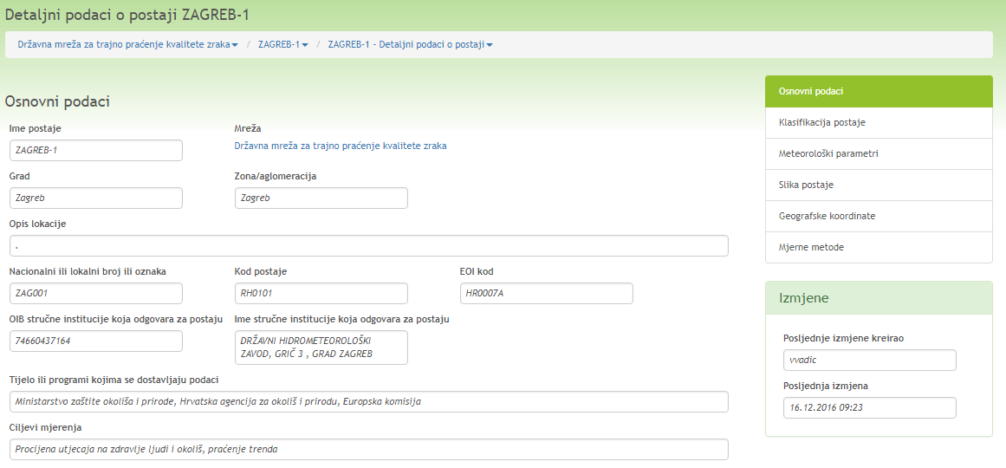
14.4 OFFICIAL DATA SUBMISSION
European Union IPA 2013 Programme for Croatia
Data on networks and stations (metadata) (D) - basic station data
Institut za energetiku i zaštitu okoliša
Energy Research and Environmental Protection Institute

Slide 30
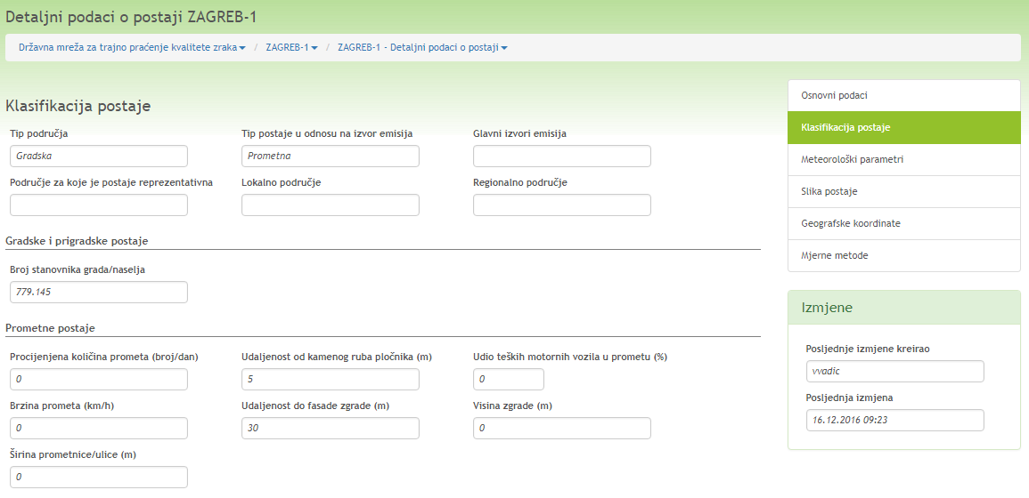
14.4 OFFICIAL DATA SUBMISSION
European Union IPA 2013 Programme for Croatia
Data on networks and stations (metadata) (D) – station classification
Institut za energetiku i zaštitu okoliša
Energy Research and Environmental Protection Institute

Slide 31
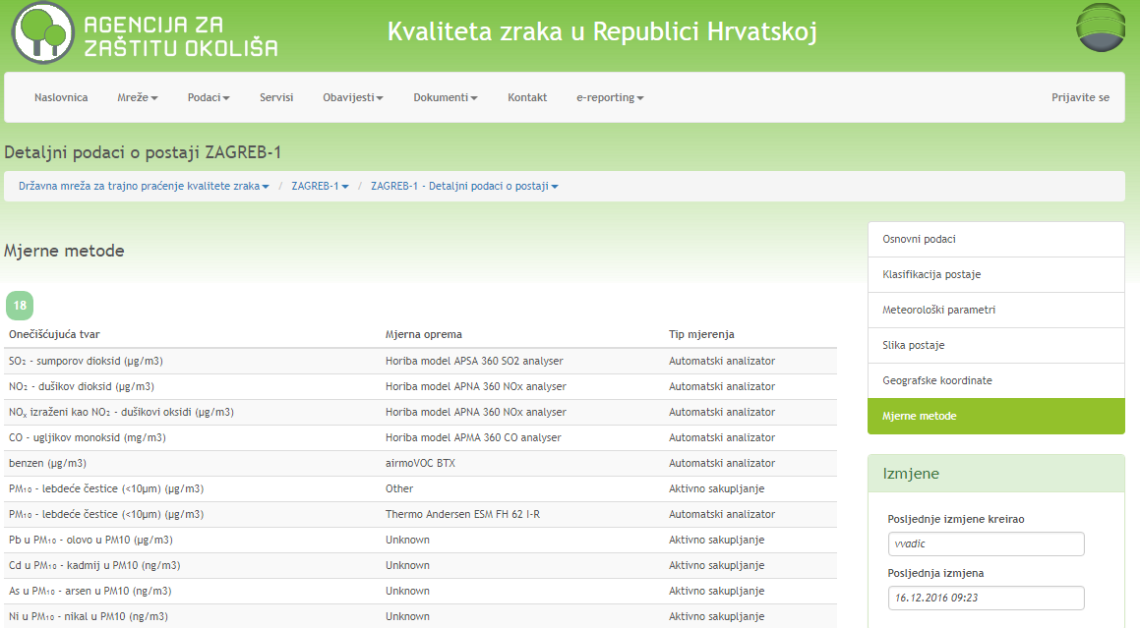
14.4 OFFICIAL DATA SUBMISSION
European Union IPA 2013 Programme for Croatia
Data on networks and stations (metadata) (D) – measurement methods
Institut za energetiku i zaštitu okoliša
Energy Research and Environmental Protection Institute

Slide 32
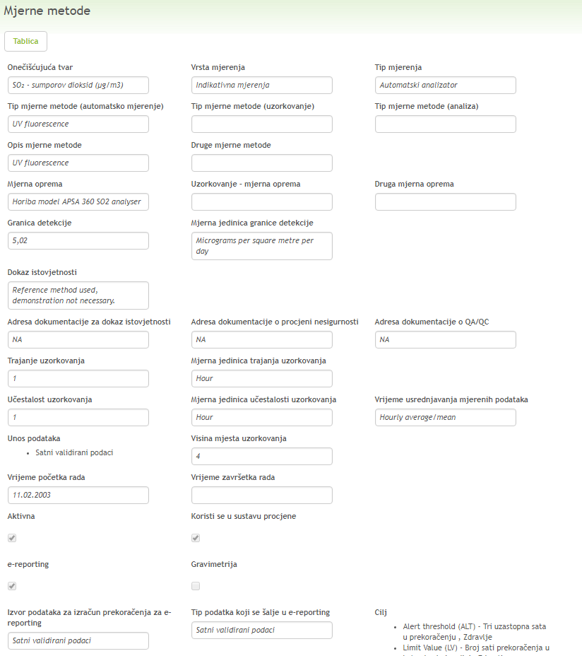
14.4 OFFICIAL DATA SUBMISSION
European Union IPA 2013 Programme for Croatia
Data on networks and stations (metadata)(D) - single measurement methods
Institut za energetiku i zaštitu okoliša
Energy Research and Environmental Protection Institute

Slide 33
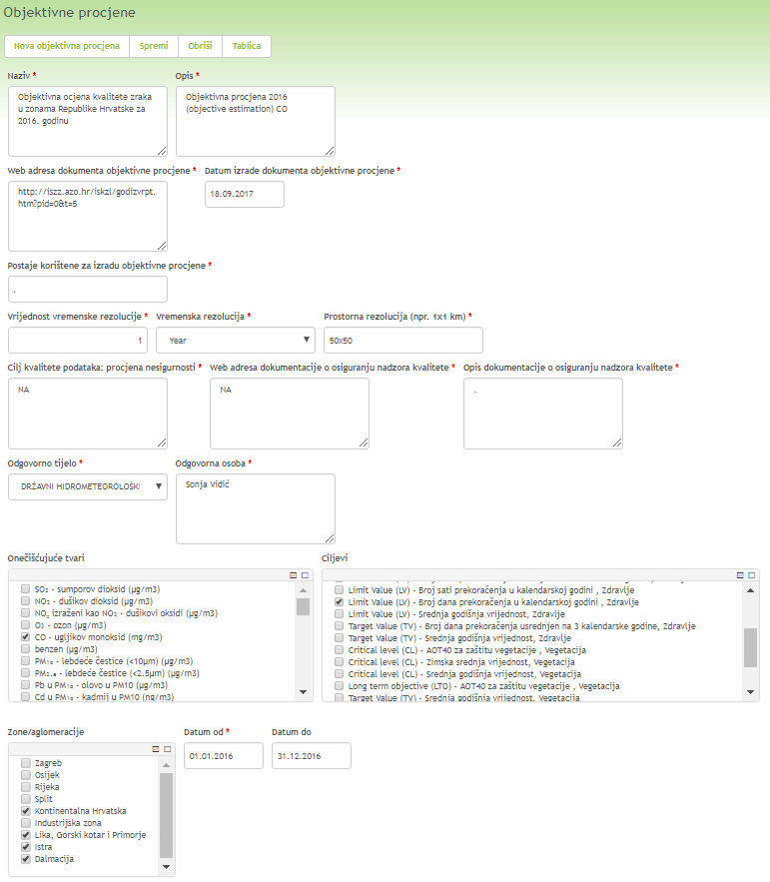
14.4 OFFICIAL DATA SUBMISSION
European Union IPA 2013 Programme for Croatia
Data on applied techniques of objective assessment (metadata) (D1b)
Institut za energetiku i zaštitu okoliša
Energy Research and Environmental Protection Institute

Slide 34
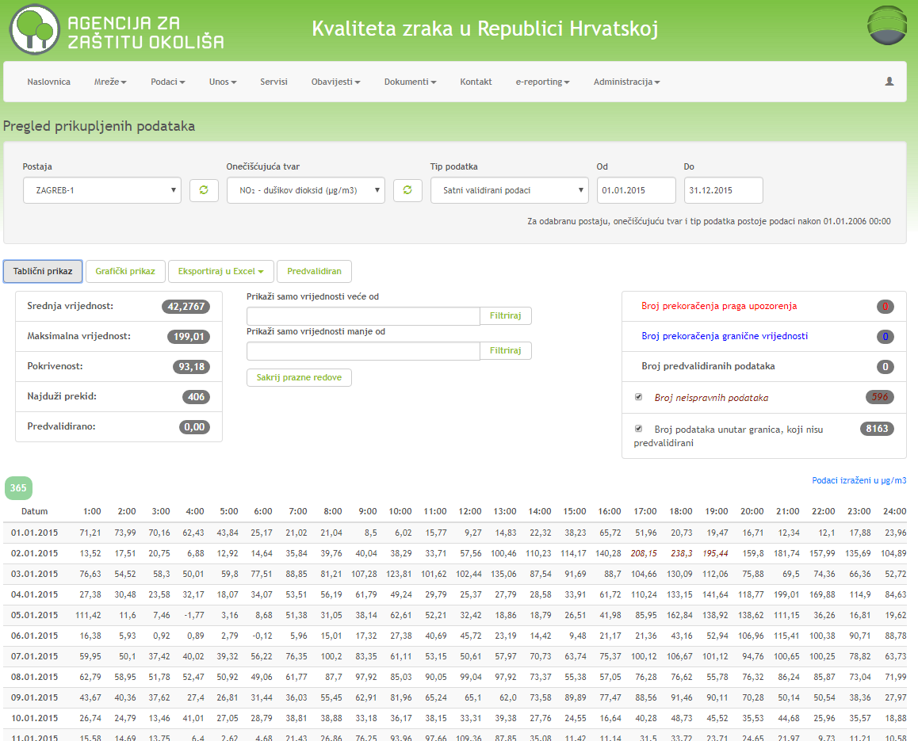
14.4 OFFICIAL DATA SUBMISSION
European Union IPA 2013 Programme for Croatia
Validated measurement data (E1a)
Institut za energetiku i zaštitu okoliša
Energy Research and Environmental Protection Institute

Slide 35
14.4 OFFICIAL DATA SUBMISSION
European Union IPA 2013 Programme for Croatia
Statistical data (F) – are not delivered (EEA does not consider those) but have to be calculated in order to determine exceedances and make an estimate
NO₂ (µg/m³)
Zona / Aglomeracija | Mjerna postaja / Modeliranje | 1-satne koncentracije |  |  |  |  |  | Ocjena onečišćenosti (sukladnosti)
 |  | OP % | C_{godina} | C_{max}* | C_{99.79}*= max. 19 sat | broj sati > GV | broj sati > PU
HR ZG | Zagreb-1 | 93 | 42 | 199 | 163 | 0 | 0
 | Zagreb-3 | 95 | 26 | 137 | 112 | 0 | 0
HR OS | Osijek-1 | 91 | 23 | 166 | 113 | 0 | 0
HR RI | Rijeka-2 | 95 | 13 | 115 | 77 | 0 | 0
HR ST | Kaštel Sućurac | 87 | 18 | 111 | 80 | 0 | 0
 | Split-1 | 96 | 24 | 134 | 114 | 0 | 0
HR 1 | Desinić | 69 | 7 | 49 | 36 | 0 | 0
HR 2 | Slavonski Brod-1 | 96 | 16 | 127 | 93 | 0 | 0
HR 4 | Pula Fižela | 95 | 11 | 82 | 63 | 0 | 0
HR 5 | Žarkovica (Dub.) | 60 | 3 | 81 | 23 | 0 | 0
Institut za energetiku i zaštitu okoliša
Energy Research and Environmental Protection Institute

Slide 36
14.4 OFFICIAL DATA SUBMISSION
European Union IPA 2013 Programme for Croatia
Statistical data (F)– are not delivered (EEA does not consider those) but have to be calculated in order to determine exceedances and make an estimate
Institut za energetiku i zaštitu okoliša
Energy Research and Environmental Protection Institute

Slide 37
14.4 OFFICIAL DATA SUBMISSION
European Union IPA 2013 Programme for Croatia
Pollution estimate (G) – achievement of environmental objectives - with exceedance of limit values and target values (comparison with limit or target values)
The assessment of zone and agglomeration pollution for the previous calendar year (conformity assessment with environmental objectives as laid down in Directives 2008/50 / EC, 2004/107 / EC) shall be determined in accordance with the list of measurement points laid down in Article 4 of the Regulation on the establishment of measurement points for concentration monitoring of individual pollutants in the air and the location of monitoring stations in the national network for permanent air quality monitoring.
Institut za energetiku i zaštitu okoliša
Energy Research and Environmental Protection Institute

Slide 38
14.4 OFFICIAL DATA SUBMISSION
European Union IPA 2013 Programme for Croatia
Pollution assessment (G)
For this purpose, a detailed analysis and processing of the data from the measurement points is performed, which are determined by the Regulation for defining the list of measurement points for monitoring concentrations of air pollutants: sulfur dioxide, nitrogen dioxide and nitrogen oxides, floating particles (PM10 and PM2,5), lead, benzene, carbon monoxide, ground-level ozone, arsenic, cadmium, mercury, nickel, benzo (a) pyrene and other polycyclic aromatic hydrocarbons in the air.
The pollution assessment (compliance) of zones and agglomerations obtained by air quality measurements may be supplemented by modeling data, objective estimate and indicative measurements in accordance with certain criteria. Thus, in estimating the pollution of zones and agglomerations in 2015, besides measurement data, data obtained by an objective assessment made by Croatian Meterorological and Hydrological Service was also used.
Institut za energetiku i zaštitu okoliša
Energy Research and Environmental Protection Institute

Slide 39
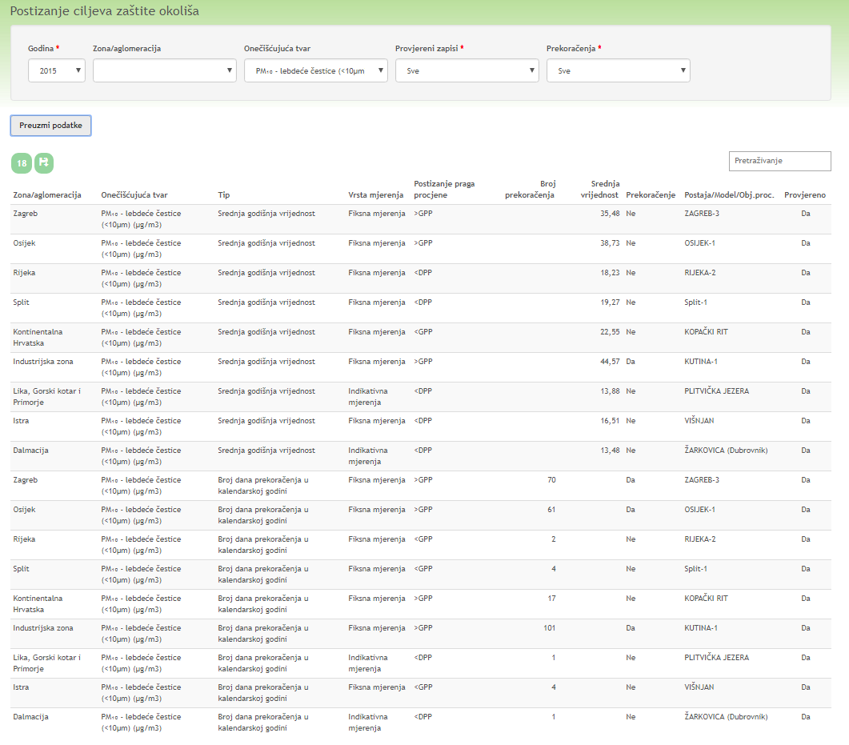
14.4 OFFICIAL DATA SUBMISSION
European Union IPA 2013 Programme for Croatia
Pollution assessment (G) – meeting environmental goals Example – submitted pollution assessment for PM₁₀
Institut za energetiku i zaštitu okoliša
Energy Research and Environmental Protection Institute

Slide 40
14.4 OFFICIAL DATA SUBMISSION
European Union IPA 2013 Programme for Croatia
Exceedance of limit and target values from measurement sites for pollution assessment of zones and agglomerations
in 2015
Institut za energetiku i zaštitu okoliša
Energy Research and Environmental Protection Institute

Slide 41
14.4 OFFICIAL DATA SUBMISSION
European Union IPA 2013 Programme for Croatia
Exceedance of limit values and target values in 2015 in agglomerations
In Zagreb agglomeration, the mean annual NO₂ value exceeded the limit value on one monitoring station (Zagreb-1). 24-hour concentrations of PM₁₀ exceeded the limit value at two monitoring stations (Zagreb-1, 47 days and Zagreb-3, 70 days). The mean annual value of BaP u PM₁₀ exceeded the limit value on two monitoring stations (Zagreb-1 and Zagreb-3). The maximum daily 8-hour ozone concentrations exceeded the target value at one monitoring station (Zagreb-3, 28 days).
In Osijek agglomeration, the 24-hour PM₁₀ concentrations exceeded the limit value at one monitoring station (Osijek-1, 60 days).
In Rijeka agglomeration, the maximum daily 8-hour ozone concentrations exceeded the target value at one monitoring station (Rijeka-2, 33 days).
Institut za energetiku i zaštitu okoliša
Energy Research and Environmental Protection Institute

Slide 42
14.4 OFFICIAL DATA SUBMISSION
European Union IPA 2013 Programme for Croatia
Exceedance of limit values and target values in 2015 in zones
In continental Croatia zone, the maximum daily 8-hour ozone concentrations exceeded the target value at one monitoring station (Desinić, 39 days).
In the Industrial zone, 24-hour PM₁₀ concentrations exceeded the limit value at two monitoring stations (Sisak-1, 67 days and Kutina-1, 100 days). The mean annual value of BaP in PM₁₀ and benzene exceeded the limit value at one monitoring station (Sisak-1). The mean annual PM_{2,5} value exceeded the limit value at one monitoring station (Slavonski Brod-1).
In Lika, Gorski Kotar and Primorje zone, maximum daily 8-hour ozone concentrations exceeded the target value at one monitoring station (Parg, 33 days).
Institut za energetiku i zaštitu okoliša
Energy Research and Environmental Protection Institute

Slide 43
14.4 OFFICIAL DATA SUBMISSION
European Union IPA 2013 Programme for Croatia
Exceedance of limit values and target values in 2015 in zones
In Istria zone, the maximum daily 8-hour ozone concentrations exceeded the target value at one monitoring station (Pula Fižela, 87 days).
(Pula Fižela, 87 dana).
In Dalmacija zone, the maximum daily 8-hour ozone concentration exceeded the target value at two monitoring stations (Hum, 75 days, Žarkovica, 36 days)
Institut za energetiku i zaštitu okoliša
Energy Research and Environmental Protection Institute

Slide 44
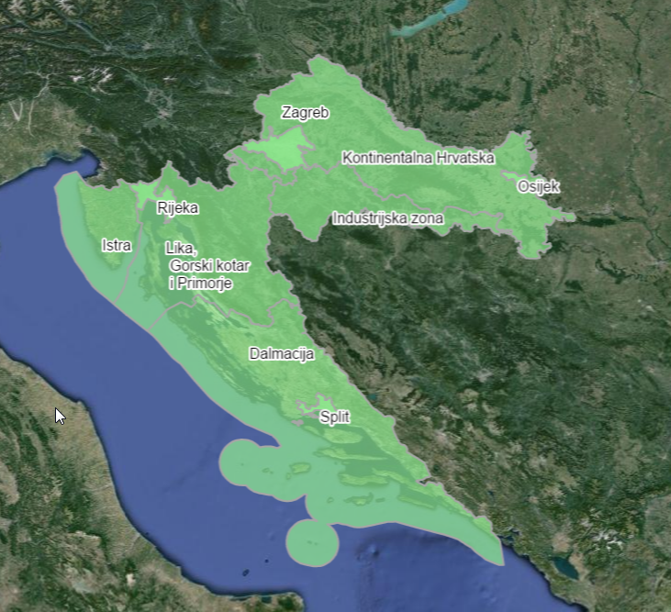
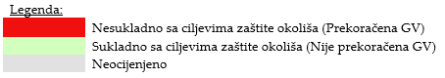
14.4 OFFICIAL DATA SUBMISSION
European Union IPA 2013 Programme for Croatia
Assessment of zones and agglomerations pollution (compliance) for 2015 – SO₂
Based on the analysis of measurement results and the objective estimate, following is estimated :
SO₂ concentrations were lower than the prescribed limit values in all zones and agglomerations
Institut za energetiku i zaštitu okoliša
Energy Research and Environmental Protection Institute

Slide 45
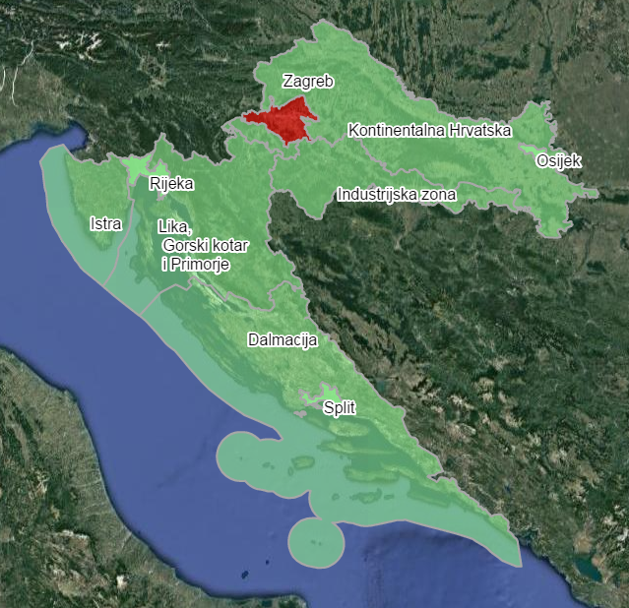
14.4 OFFICIAL DATA SUBMISSION
European Union IPA 2013 Programme for Croatia
Assessment of zones and agglomerations pollution (compliance) for 2015. – NO₂
Based on the analysis of the measurement results and the objective evaluation following is estimated:
NO₂ concentrations were above the prescribed mean annual limit values in the agglomeration of Zagreb at the Zagreb-1 monitoring station.
NO₂ concentrations were lower than the prescribed limit values in all other agglomerations (Osijek, Rijeka and Split) and in all zones.
Institut za energetiku i zaštitu okoliša
Energy Research and Environmental Protection Institute

Slide 46
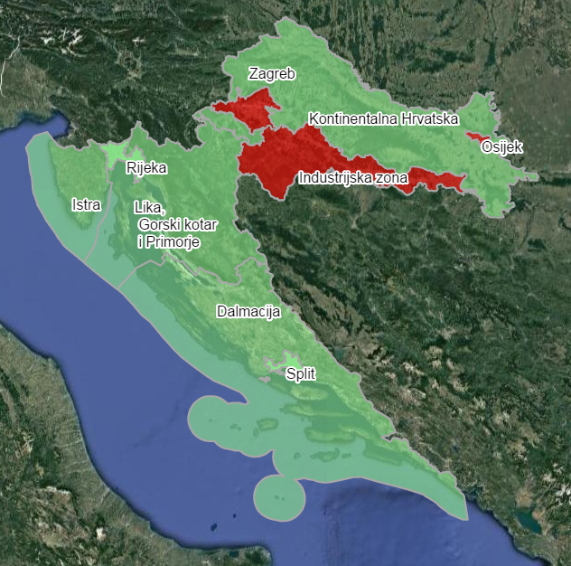
14.4 OFFICIAL DATA SUBMISSION
European Union IPA 2013 Programme for Croatia
Assessment of zones and agglomerations pollution (compliance) for 2015 – PM₁₀
Based on the analysis, following is estimated:
- concentrations of PM₁₀ floating particles were higher than the prescribed limit values in the agglomerations of Zagreb and Osijek and the Industrial Zone (HR 2).
In the agglomerations of Rijeka and Split and the continental Croatia (HR 1), Lika, Gorski kotar and Primorje (HR 3), Istria (HR 4) and Dalmatia (HR 5) concentrations of PM10 floating particles were lower than the prescribed limit values.
Institut za energetiku i zaštitu okoliša
Energy Research and Environmental Protection Institute

Slide 47
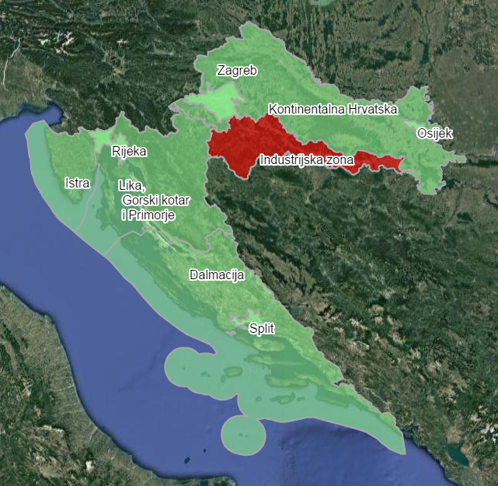
14.4 OFFICIAL DATA SUBMISSION
European Union IPA 2013 Programme for Croatia
Assessment of zones and agglomerations pollution (compliance) for 2015– PM_{2,5}
PM_{2,5} concentrations were:
- more than the prescribed limit value in the Industrial Zone (HR 2).
- lower than the LV in the agglomerations of Zagreb, Rijeka and Split and in the areas of continental Croatia (HR 1), Lika, Gorski kotar and Primorje (HR 3), Istria (HR 4) and Dalmatia (HR 5).
-- The estimate for Osijek agglomeration was given on the basis of the measurement results from monitoring stations Kopački rit (nearest monitoring station) and ZAGREB PPI PM2,5 - Ksaverska cesta (city background monitoring station).
Institut za energetiku i zaštitu okoliša
Energy Research and Environmental Protection Institute

Slide 48
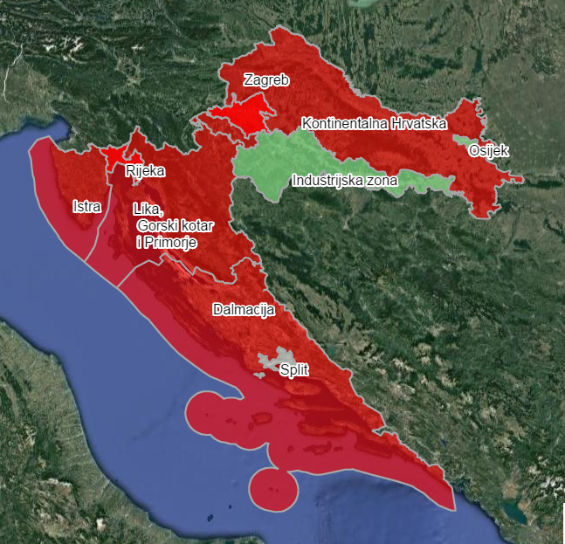
14.4 OFFICIAL DATA SUBMISSION
European Union IPA 2013 Programme for Croatia
Assessment of zones and agglomerations pollution (compliance) for 2015– O₃
On the basis of the analysis of the data obtained by measuring, it was estimated that the concentrations of ozone were higher than the prescribed target values in the agglomerations of Zagreb and Rijeka and in the zones Continental Croatia (HR 1), Lika, Gorski kotar and Primorje (HR 3), Istria (HR 4) and Dalmatia (HR 5). - In Industrial zone (HR 2) and Osijek agglomeration the ozone concentration were lower than the prescribed target values.
-Split agglomeration was not assessed
Institut za energetiku i zaštitu okoliša
Energy Research and Environmental Protection Institute

Slide 49
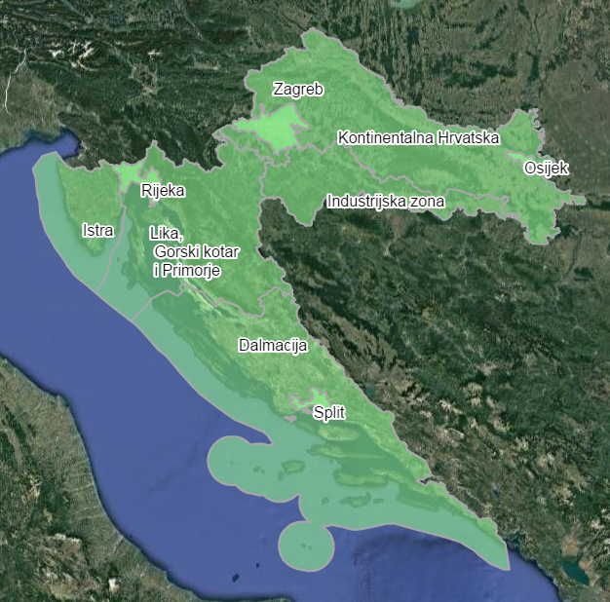
14.4 OFFICIAL DATA SUBMISSION
European Union IPA 2013 Programme for Croatia
Assessment of zones and agglomerations pollution (compliance) for 2015 – CO
Based on indicative measurements and objective / expert estimate, it was estimated that the CO concentrations were lower than the prescribed limit values in all zones and agglomerations.
Institut za energetiku i zaštitu okoliša
Energy Research and Environmental Protection Institute

Slide 50

14.4 OFFICIAL DATA SUBMISSION
European Union IPA 2013 Programme for Croatia
Assessment of zones and agglomerations pollution (compliance) for 2015– benzene
It was estimated that benzene concentrations were lower than the prescribed LVs in all agglomerations.
- In the Industrial zone (HR 2) at the Sisak-1 terminal monitoring station, benzene concentrations were higher than the limit value.
- The objective / expert estimate showed that the average annual values of benzene did not exceed the LV in the zones of continental Croatia (HR 1), Lika, Gorski kotar and Primorje (HR 3), Istria (HR 4) and Dalmatia (HR 5) in 2015 .
Institut za energetiku i zaštitu okoliša
Energy Research and Environmental Protection Institute

Slide 51
14.4 OFFICIAL DATA SUBMISSION
European Union IPA 2013 Programme for Croatia
Assessment of zones and agglomerations pollution (compliance) for 2015 – Cd, Ni, As and Pb in PM₁₀
On the basis of measurement results and objective estimates it was estimated that the Cd, Ni, As and Pb concentrations in PM₁₀ were lower than the prescribed limit or target values in all zones and agglomerations
Institut za energetiku i zaštitu okoliša
Energy Research and Environmental Protection Institute

Slide 52
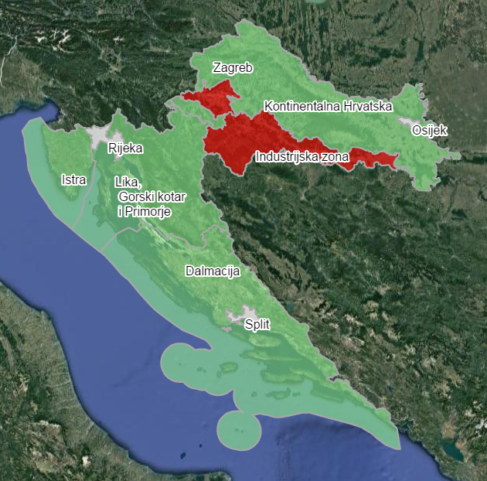
14.4 OFFICIAL DATA SUBMISSION
European Union IPA 2013 Programme for Croatia
Assessment of zones and agglomerations pollution (compliance) for 2015 – B(a)P in PM₁₀
Concentrations B (a) P in PM₁₀ were higher than the prescribed target values in the agglomeration of Zagreb at the Zagreb-1 and Zagreb-3 measuring stations as well as at the Industrial zone (HR 2) at the Sisak-1 monitoring station.
Based on the values of the total BaP concentration in the air obtained from the model, it is estimated that the mean annual values of BaP in PM₁₀ have not exceeded the target values in the zones of Continental Croatia (HR 1), Lika, Gorski kotar and Primorje (HR 3), Istria (HR 4) Dalmatia (HR 5)
Institut za energetiku i zaštitu okoliša
Energy Research and Environmental Protection Institute

Slide 53
14.4 OFFICIAL DATA SUBMISSION
European Union IPA 2013 Programme for Croatia
Summary assessment of zones and agglomerations pollution (non-compliance) for 2015
Sulfur dioxide SO2
• All zones and agglomerations are rated as pure.
Nitrogen dioxide NO2
• Zagreb agglomeration is rated as polluted.
• Other agglomerations and all zones are rated as pure.
Institut za energetiku i zaštitu okoliša
Energy Research and Environmental Protection Institute

Slide 54
14.4 OFFICIAL DATA SUBMISSION
European Union IPA 2013 Programme for Croatia
Summary assessment of zones and agglomerations pollution (non-compliance) for 2015
Particulate matter PM₁₀
• Zagreb and Osijek agglomerations and Industrial zone are rated as polluted.
• Rijeka and Split agglomerationa and the zones of Continental Croatia, Istria, Lika, Gorski kotar and Primorje and Dalmatia are rated as pure.
Particulate matter PM_{2,5}
• Industrial zone is rated as polluted.
• Zagreb Osijek, Rijeka and Split agglomerations, as well as other zones, are rated as pure.
Institut za energetiku i zaštitu okoliša
Energy Research and Environmental Protection Institute

Slide 55
14.4 OFFICIAL DATA SUBMISSION
European Union IPA 2013 Programme for Croatia
Summary assessment of zones and agglomerations pollution (non-compliance) for 2015
Ozone O ₃
• The zones of Continental Croatia, Lika, Gorski kotar and Primorje, Istria and Dalmatia are rated as polluted, as well as Zagreb and Rijeka agglomerations.
• Osijek agglomeration and Industrial zone are rated as pure.
• Split agglomeration was not rated.
Carbon monoxide CO
• All zones and agglomerations are rated as pure.
Institut za energetiku i zaštitu okoliša
Energy Research and Environmental Protection Institute

Slide 56
14.4 OFFICIAL DATA SUBMISSION
European Union IPA 2013 Programme for Croatia
Summary assessment of zones and agglomerations pollution (non-compliance) for 2015
Benzene
• Industrial zone is rated as polluted.
• Other zones were rated as pure.
• All agglomerations are rated as pure.
Carbon monoxide CO
• All zones and agglomerations are rated as pure.
Institut za energetiku i zaštitu okoliša
Energy Research and Environmental Protection Institute

Slide 57
14.4 OFFICIAL DATA SUBMISSION
European Union IPA 2013 Programme for Croatia
Summary assessment of zones and agglomerations pollution (non-compliance) for 2015
Benzene
• Industrial zone is rated as polluted.
• Other zones were rated as pure.
• All agglomerations are rated as pure.
Pb, Cd, Ni, As in PM₁₀
• All zones and agglomerations are rated as pure.
Institut za energetiku i zaštitu okoliša
Energy Research and Environmental Protection Institute

Slide 58
14.4 OFFICIAL DATA SUBMISSION
European Union IPA 2013 Programme for Croatia
Summary assessment of zones and agglomerations pollution (non-compliance) for 2015
B(a)P in PM10
• Zagreb agglomeration and Industrial zone are rated as polluted.
• Other zones were rated as pure.
• Osijek, Rijeka and Split agglomerations were not rated.
Institut za energetiku i zaštitu okoliša
Energy Research and Environmental Protection Institute

Slide 59
14.5 ACTION PLAN DATA SUBMISSION
European Union IPA 2013 Programme for Croatia
Action plans (information H-K)
Health Protection Act – if air pollutant levels exceed any limit or target value in a particular zone or agglomeration in each of these cases an action plan for improving the air quality for that zone or agglomeration is introduced in the shortest time possible in order to ensure achievement of limit or target values.
Action Plan for air quality improvement covers all relevant pollutants, and may also include special measures aimed at protecting vulnerable groups of the population, including children.
Institut za energetiku i zaštitu okoliša
Energy Research and Environmental Protection Institute

Slide 60
14.5 ACTION PLAN DATA SUBMISSION
European Union IPA 2013 Programme for Croatia
Action plans
If more units of local self-government, i.e. the City of Zagreb belong to the same zone or agglomeration in which pollutant levels exceed any limit or target value, they cooperate in drawing up an action plan to harmonize the measures.
The competent administrative body of the local self-government unit or the City of Zagreb shall ensure the development of an action plan.
The representative body of the local self-government unit or the City of Zagreb implements an action plan for its administrative area.
Institut za energetiku i zaštitu okoliša
Energy Research and Environmental Protection Institute

Slide 61
14.5 ACTION PLAN DATA SUBMISSION
Action plan contains specifically following:
identifying locations of excessive pollution,
general information,
the competent responsible authority,
type and assessment of contamination, origin of contamination,
analysis of the state,
details of the measures taken,
measures to reduce air pollution,
order and deadlines for the implementation of measures
and estimate of resources.
Institut za energetiku i zaštitu okoliša
Energy Research and Environmental Protection Institute

Slide 62
14.5 ACTION PLAN DATA SUBMISSION
European Union IPA 2013 Programme for Croatia
The mandatory elements of the Action Plan for Air Quality Improvement are prescribed in Part I of the Annex to the Regulation on mutual information exchange and reporting on air quality and obligations for implementation of Commission Decision 2011/850 / EU (Official Gazette, No 3/16)
Institut za energetiku i zaštitu okoliša
Energy Research and Environmental Protection Institute

Slide 63
14.5 ACTION PLAN DATA SUBMISSION
European Union IPA 2013 Programme for Croatia
According to the amendments to the Air Protection Act (OG 61/17), the Action Plan is implemented within 18 months of the end of the year in which the exceedance was noted and the competent authority of the local self-government unit submits to the Agency the implemented Action Plan for the purposes of Air Protection Information System.
Exceptionally, the action plan for exceedances established at the measurement sites referred to in Article 19, paragraph 5 of the Air Protection Act (measurement points used for mutual exchange of information and reporting on air quality between the Agency and the European Commission), is submitted by the competent authority of the local self-government unit for the review of the Ministry and the Agency prior to its adoption and at the latest within 15 months of the end of the year in which the exceedance was established.
Institut za energetiku i zaštitu okoliša
Energy Research and Environmental Protection Institute

Slide 64
14.5 ACTION PLAN DATA SUBMISSION
European Union IPA 2013 Programme for Croatia
Information on the action plan for exceeding the limit and target values from the measurement points established by the Regulation on the establishment of a list of measurement points for monitoring concentrations of certain pollutants in the air and the location of the monitoring stations in the national network for permanent air quality monitoring (Official Gazette 65/16) are submitted to the Agency immediately upon adoption of the Action Plan. (do not wait 18/15 months)
The Agency shall submit information on the action plans to the EC immediately upon receipt and at the latest 2 years after the end of the calendar year in which the first exceedance was recorded.
According to the requirements of Implementing Decision 2011/850 / EC the data are submitted electronically (XML format), and the reference form for entering and submitting the data is on the Air Quality portal in the Republic of Croatia.
Institut za energetiku i zaštitu okoliša
Energy Research and Environmental Protection Institute

Slide 65
14.5 ACTION PLAN DATA SUBMISSION
European Union IPA 2013 Programme for Croatia
Information on action plans to be delivered to EC are following:
Information on Action Plans for Air Quality Improvement (H) - this is general information on action plans: plan name, year of first exceedance, responsible authority, pollutants covered, date of plan implementation, time schedule of implementation ...
Source Distribution Information (I) - this is information on source apportionment, or contribution to pollution: local, regional, urban
Scenario information for the year of achievement (J) - this is information about the initial and projection scenario for the year of reaching the limit value. The initial scenario is without taking measures, and the projection scenario is with the measures taken
Information on measures to improve air quality (K) - information on measures taken to achieve limit and / or target values: type of measure, time period of measure, sectors and areas which the measure affects, emission reduction due to measure implementation and expected influence on concentrations
Institut za energetiku i zaštitu okoliša
Energy Research and Environmental Protection Institute

Slide 66
14.5 ACTION PLAN DATA SUBMISSION
European Union IPA 2013 Programme for Croatia
Information on action plans (Information H-K) shall be submitted by the representative body of the local self-government unit to the Agency in the air protection information system in electronic form using the formats and protocols of Commission Decision 2011/850 / EU published by the Agency on its web site.
All information submitted to the EC is publicly available on the Air Quality portal in the Republic of Croatia on the following links:
http://iszz.azo.hr/iskzl/hPlan.htm
http://iszz.azo.hr/iskzl/iSourceAppointment.htm
http://iszz.azo.hr/iskzl/jEvaluation.htm
http://iszz.azo.hr/iskzl/kMeasure.htm
Institut za energetiku i zaštitu okoliša
Energy Research and Environmental Protection Institute

Slide 67
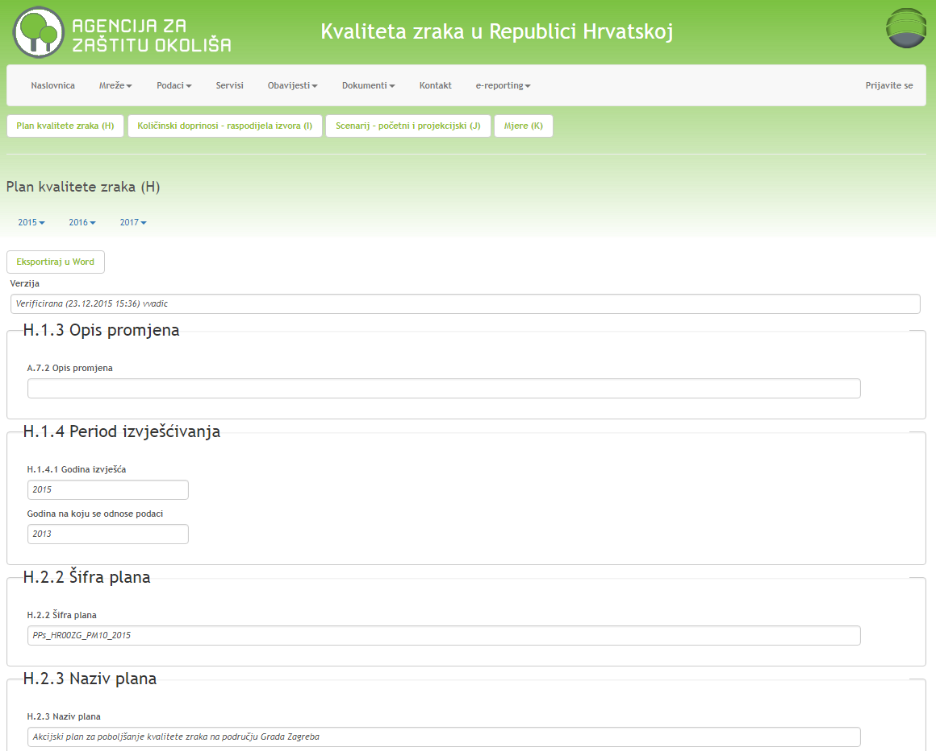
14.5 ACTION PLAN DATA SUBMISSION
European Union IPA 2013 Programme for Croatia
Information on action plans for air quality improvement (H)
- općenite informacije o akcijskim planovima: ime plana, godina prvog prekoračenja, odgovorno tijelo, obuhvaćene onečišćujuće tvari, datum donošenja plana, vremenski plan provedbe …..
http://iszz.azo.hr/iskzl/hPlan.htm?id=5
Institut za energetiku i zaštitu okoliša
Energy Research and Environmental Protection Institute

Slide 68
14.5 ACTION PLAN DATA SUBMISSION
European Union IPA 2013 Programme for Croatia
Information on action plans for air quality improvement(H)
H.1.3 Description of changes (if any)
H.1.4 Reporting Period
H.1.4.1 Year Report
H.2.2 Plan code
H.2.3 Name of plan
H.2.4 Competent authority
H.2.5 Reference year of first exceedance
H.2.6 Status
H.2.7 Pollutants covered by the plan
H.2.8 Date of official adoption of the plan
H.2.9 Scheduled Implementation Schedule
H.2.10 Link to air quality plan
H.2.11 Application link
H.2.12 Related Publications
H.2.13 Comment
H.2.14 Information on exceedance statement
Institut za energetiku i zaštitu okoliša
Energy Research and Environmental Protection Institute

Slide 69
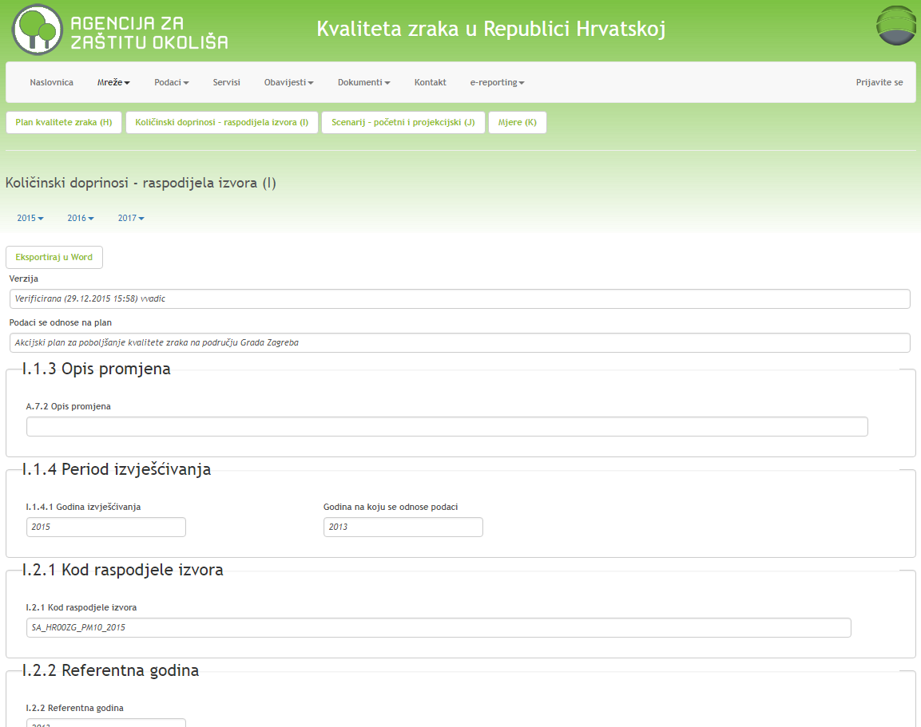
14.5 ACTION PLAN DATA SUBMISSION
European Union IPA 2013 Programme for Croatia
Quantitative contributions– source apportionment (I)
-source apportionment information, i.e. contribution to pollution: local, regional, urban …
http://iszz.azo.hr/iskzl/iSourceAppointment.htm
Institut za energetiku i zaštitu okoliša
Energy Research and Environmental Protection Institute

Slide 70
14.5 ACTION PLAN DATA SUBMISSION
European Union IPA 2013 Programme for Croatia
Quantitative contributions– source apportionment (I)
I.1.3 Description of changes (if any)
I.1.4 Reporting Period
I.1.4.1 Year of Reporting
I.2.1 When allocating the source
I.2.2 Reference year
I.2.3 Plan code
I.2.4 Assessment of urban impacts
I.2.5 Local Impact Assessment
I.2.6 Exceedance
Numerical value of exceedance (mean annual value)
Number of exceedances (days / hours)
Assessment method
Reduction of the assessment method
Information on population and exposed ecosystem and vegetation in the area of exceedance
I.2.7 Comments
I.2.8 Link to Plan (data "H")
I.2.9 Link to Exceedance (data "G")
Institut za energetiku i zaštitu okoliša
Energy Research and Environmental Protection Institute

Slide 71
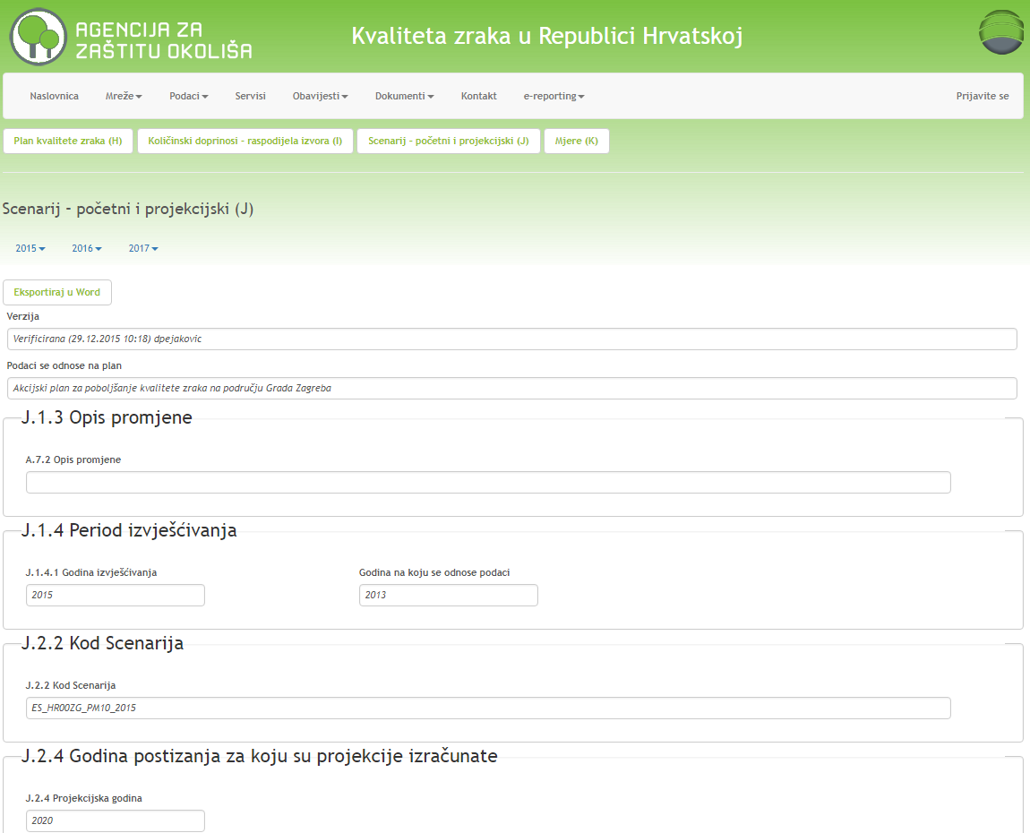
14.5 ACTION PLAN DATA SUBMISSION
European Union IPA 2013 Programme for Croatia
Scenario – initial and projection (J)
- information on initial and projection scenario for the year of achieving the limit value. The initial scenario is without taking measures, and the projection scenario is with the measures taken ...
http://iszz.azo.hr/iskzl/jEvaluation.htm
Institut za energetiku i zaštitu okoliša
Energy Research and Environmental Protection Institute

Slide 72
14.5 ACTION PLAN DATA SUBMISSION
European Union IPA 2013 Programme for Croatia
Scenario – initial and projection (J)
J.1.3 Description of change
J.1.4 Reporting Period
J.1.4.1 Year of Reporting
J.2.2 Scenario code
J.2.3 Relevant publications
J.2.4 The year for which projections are calculated
J.2.5 Start of the year
J.2.6 Initial scenario
J.2.6.1 Description of Initial Scenario
J.2.6.2 Total emissions (kt / year)
J.2.6.3 Expected level of concentration [μg / m3]
J.2.6.4 Expected Exceedances
J.2.6.5 Comments
J.2.6.6 Measures from the plan included in the initial scenario
J.2.7 Projection scenario
J.2.7.1 Description of the Projection Scenario
J.2.7.2 Total emissions (kt / year)
J.2.7.3 Expected concentration level
J.2.7.4 Expected exceedances
J.2.7.5 Comments
J.2.7.6 Measures from the plan included in the projection
J.2.8 Link to Plan (data "H")
J.2.9 Link to Source apportionment (Data "I")
Institut za energetiku i zaštitu okoliša
Energy Research and Environmental Protection Institute

Slide 73
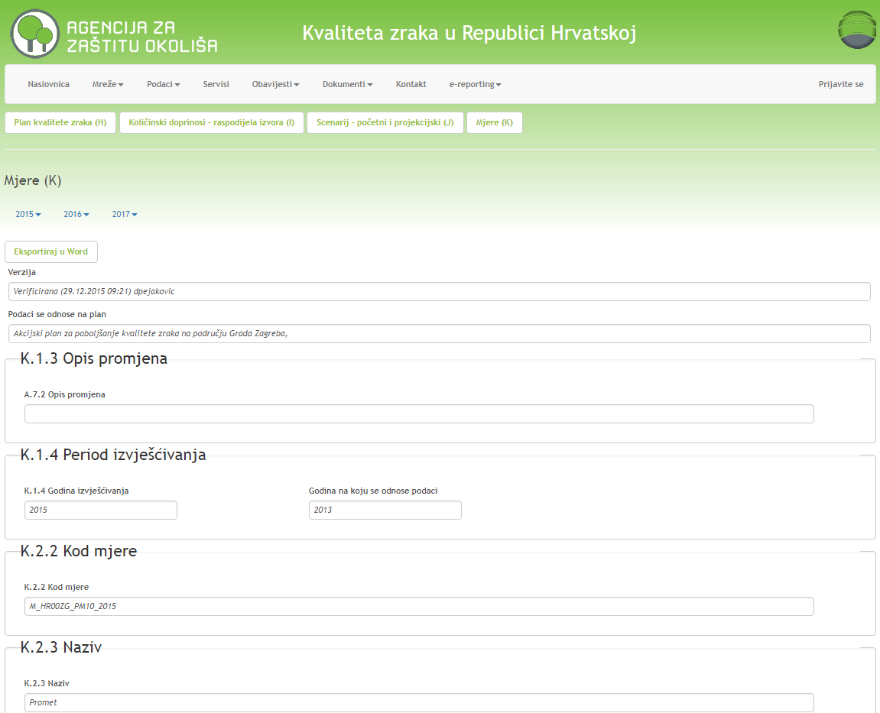
14.5 ACTION PLAN DATA SUBMISSION
European Union IPA 2013 Programme for Croatia
Measures (K)
- information on measures taken to achieve limit and / or target values: type of measure, duration of measure, sectors and areas affected by the measure, reduction of emissions due to measure implementation and expected impact on concentrations ...
http://iszz.azo.hr/iskzl/kMeasure.htm?id=6
Institut za energetiku i zaštitu okoliša
Energy Research and Environmental Protection Institute

Slide 74
14.5 ACTION PLAN DATA SUBMISSION
European Union IPA 2013 Programme for Croatia
K.2.10 Sources affected by the measure
K.2.11 Area affected by the measure
K.2.12 Planning Implementation
Implementation status (planned and actual starting and end dates) and Scheduled date when the measure should produce a full effect
K.2.13 Reduction of emission due to measure application
K.2.14 Expected impact on concentrations
K.2.14.1 Value
K.2.14.2 Number of exceedances (Hours or Days)
K.2.15 Comment for clarification
K.2.16 Link to Source apportionment (Data "I")
K.2.17 Link to Scenario (Data "J")
Measures (K)
K.1.3 Description of change
K.1.4 Reporting Period
K.1.4.1 Year of Reporting
K.2.2 Measurements
K.2.3 Name of measure
K.2.4 Description of measure
K.2.5 Classification of measures
K.2.6 Type of measure
K.2.7 Administrative level
K.2.8 Time period of measure
K.2.9 Costs
K.2.9.1 Estimated Costs
K.2.9.2 Final Costs
K.2.9.3 Currency
K.2.9.4 Comment
Institut za energetiku i zaštitu okoliša
Energy Research and Environmental Protection Institute

Slide 75
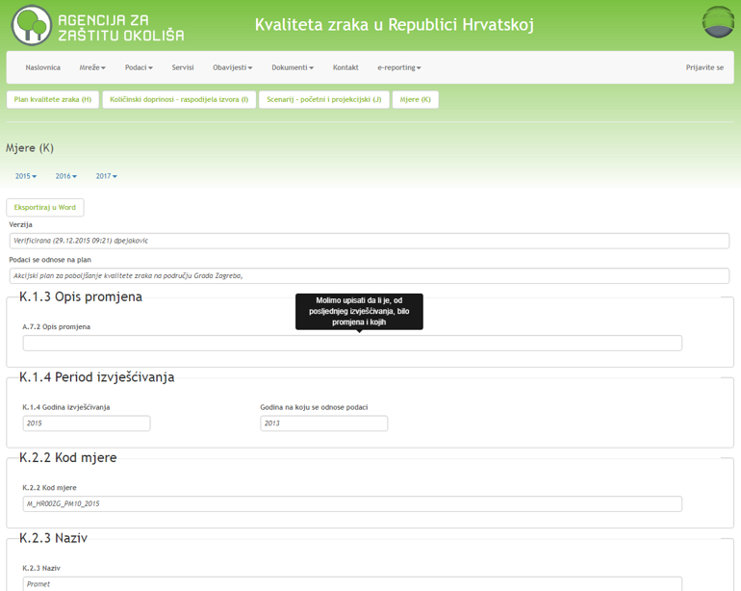
14.5 ACTION PLAN DATA SUBMISSION
European Union IPA 2013 Programme for Croatia
In all H-K forms, most of the fields have additional explanation about what exactly should be entered in that field, which is shown when the cursor is placed in that field
Institut za energetiku i zaštitu okoliša
Energy Research and Environmental Protection Institute

Slide 76
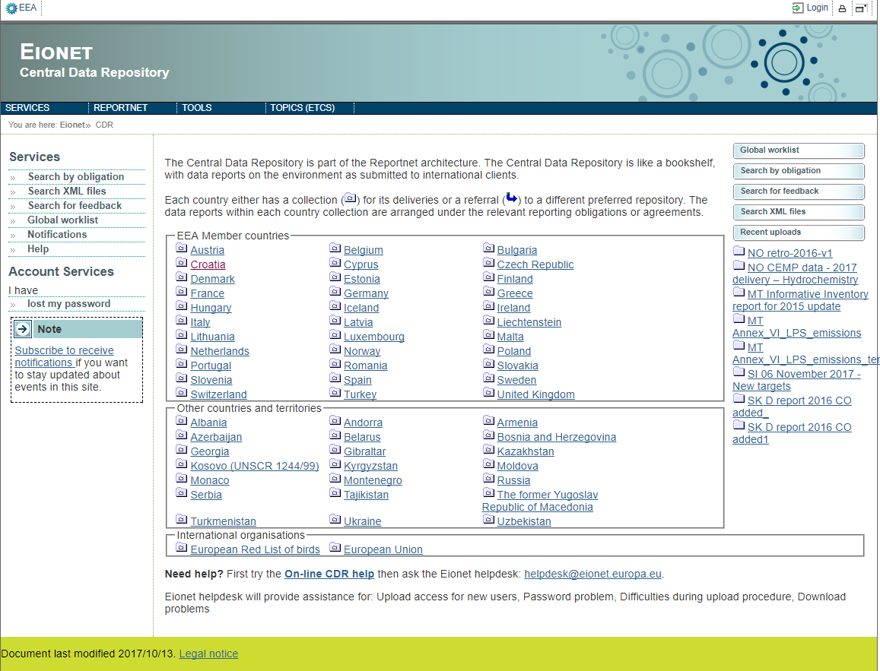

14.6 EIONET – CENTRAL DATA REPOSITORY
European Union IPA 2013 Programme for Croatia
CENTRAL DATA REPOSITORY is a central repository / storage / data space that is part of ReportNet. (ReportNet is a group of web applications and processes developed by the EEA to support international environmental reporting).
CDR - The central data repository / storage / space is like a bookcase, with environmental data submitted to it
Each country has their own
( ) map for data submission.
https://cdr.eionet.europa.eu/
http://eeadmz1-cws-wp-air.azurewebsites.net/toolbox-for-e-reporting/repository/
Institut za energetiku i zaštitu okoliša
Energy Research and Environmental Protection Institute

Slide 77
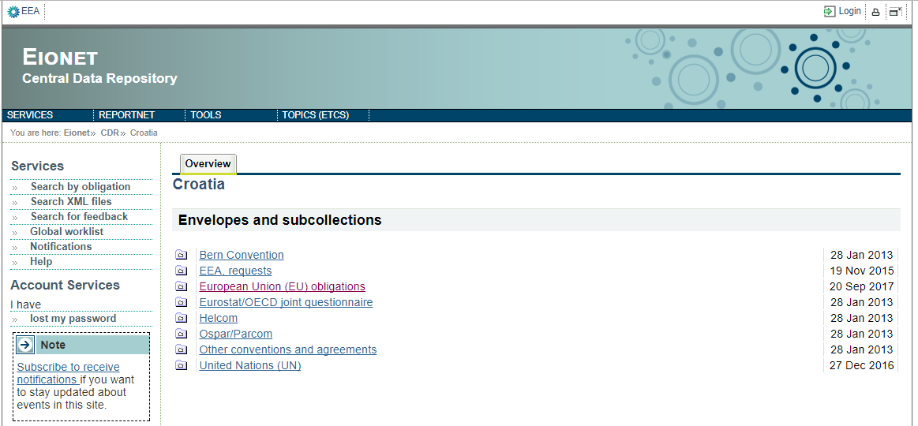
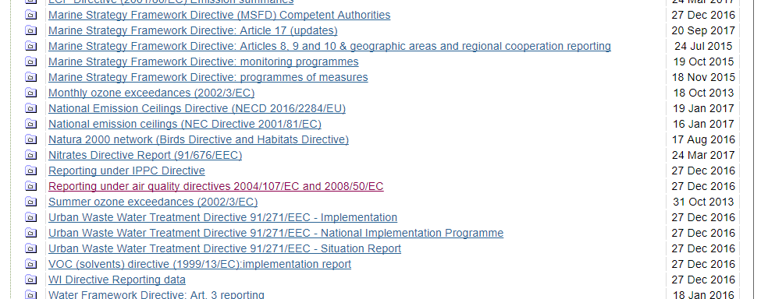
14.6 EIONET – CENTRAL DATA REPOSITORY
European Union IPA 2013 Programme for Croatia
Submitted data within each country are organized according to relevant reporting obligations or agreements.
http://cdr.eionet.europa.eu/hr
http://cdr.eionet.europa.eu/hr/eu/
http://eeadmz1-cws-wp-air.azurewebsites.net/toolbox-for-e-reporting/repository/
Institut za energetiku i zaštitu okoliša
Energy Research and Environmental Protection Institute

Slide 78
14.6 EIONET – CENTRAL DATA REPOSITORY
European Union IPA 2013 Programme for Croatia
By accession to the European Union, the Republic of Croatia has undertaken to submit information / data on air quality to the European Commission.
For this reason, in 2014 HAOP developed the portal "Air Quality in the Republic of Croatia", which contains all the information required for IPR reporting, and allows to generate.xml files that are delivered to the CDR.
From 2014 (data for 2013, 2013 - was the first year for which official data had to be submitted) The Republic of Croatia submits air quality data to the European Commission and thus fulfills all its air quality reporting requirements required by the implementing Decision 2011/850 / EU for Directives 2008/50 / EC and 2004/107 / EC.
http://eeadmz1-cws-wp-air.azurewebsites.net/toolbox-for-e-reporting/repository/
Institut za energetiku i zaštitu okoliša
Energy Research and Environmental Protection Institute

Slide 79
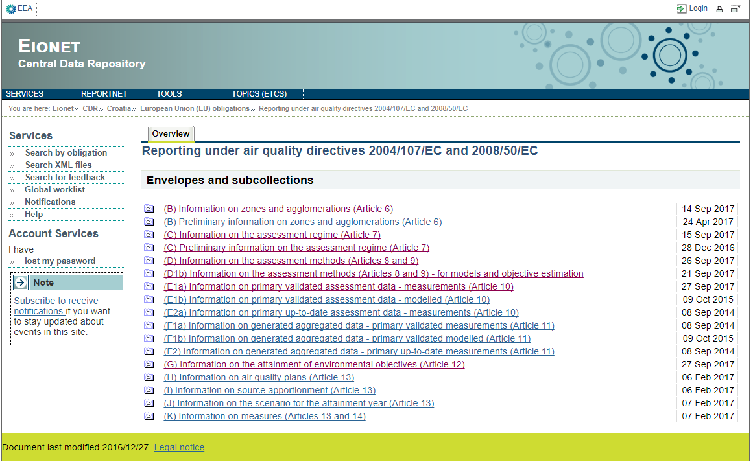
14.6 EIONET – CENTRAL DATA REPOSITORY
European Union IPA 2013 Programme for Croatia
Data submitted by the Republic of Croatia on air quality on CDR in accordance with Directives 2008/50 / EC and 2004/17 / EC
All data
– from B to G
and from H to K
http://cdr.eionet.europa.eu/hr/eu/aqd
Institut za energetiku i zaštitu okoliša
Energy Research and Environmental Protection Institute

Slide 80
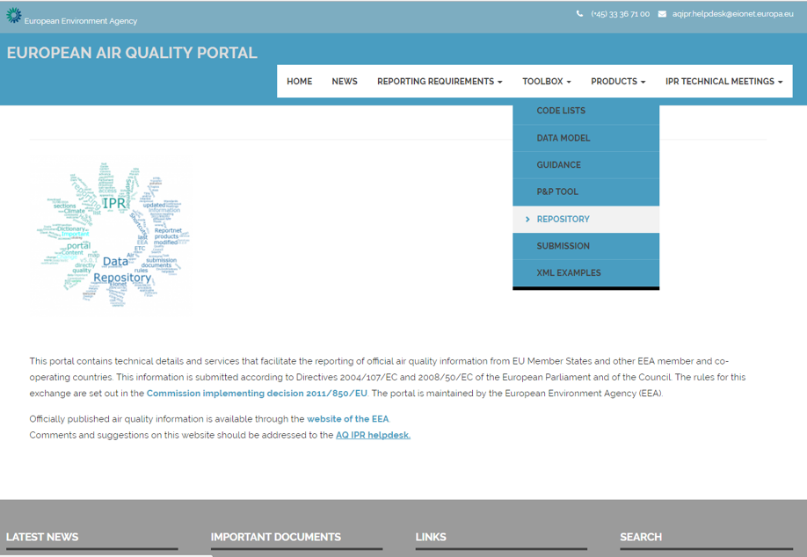
14.6 EIONET – CENTRAL DATA REPOSITORY
European Union IPA 2013 Programme for Croatia
EUROPEAN AIR QUALITY PORTAL
http://eeadmz1-cws-wp-air.azurewebsites.net/
CDR can be accessed via European
Air Quality Portal developed and maintained by the European Environment Agency EEA
Institut za energetiku i zaštitu okoliša
Energy Research and Environmental Protection Institute

Slide 81
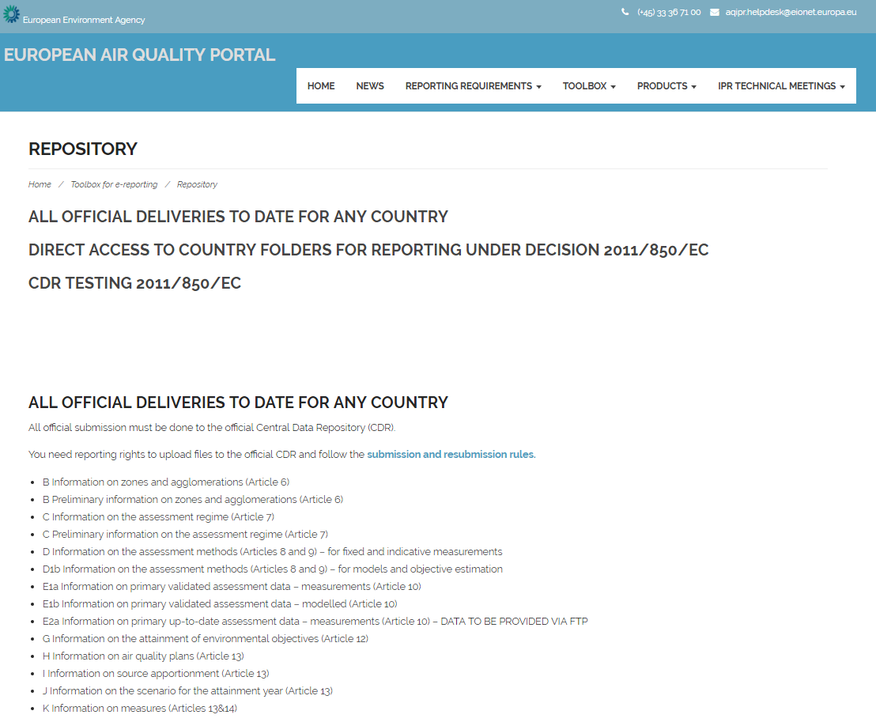
14.6 EIONET – CENTRAL DATA REPOSITORY
European Union IPA 2013 Programme for Croatia
From here all officially submitted air quality data that are obligatory delivered according to Decision 2011/850 / EC can be accessed….
http://eeadmz1-cws-wp-air.azurewebsites.net/toolbox-for-e-reporting/repository/
Institut za energetiku i zaštitu okoliša
Energy Research and Environmental Protection Institute

Slide 82
14.6 EIONET – CENTRAL DATA REPOSITORY
European Union IPA 2013 Programme for Croatia
Data on CDR for Croatia
All data
– from B to G
and from H to K
Each type of data is ina separate folder
http://cdr.eionet.europa.eu/hr/eu/aqd
Institut za energetiku i zaštitu okoliša
Energy Research and Environmental Protection Institute

Slide 83
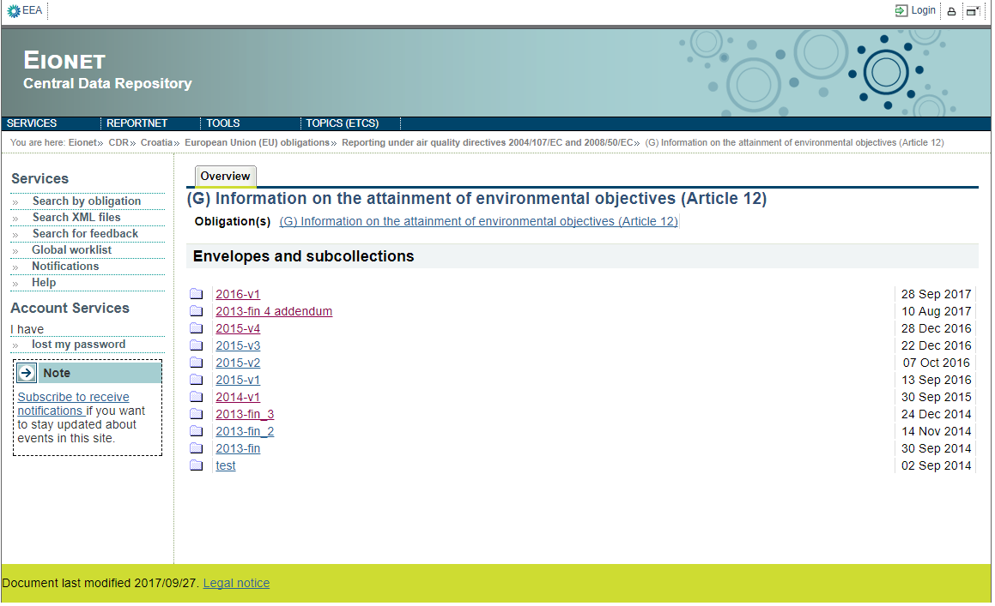
14.6 EIONET – CENTRAL DATA REPOSITORY
European Union IPA 2013 Programme for Croatia
Data on CDR for Croatia
In each type of data, there are folders by years of delivery - the latest maps for each year contain the most recent sent data – those are the valid ones
http://cdr.eionet.europa.eu/hr/eu/aqd/g/
Institut za energetiku i zaštitu okoliša
Energy Research and Environmental Protection Institute

Slide 84
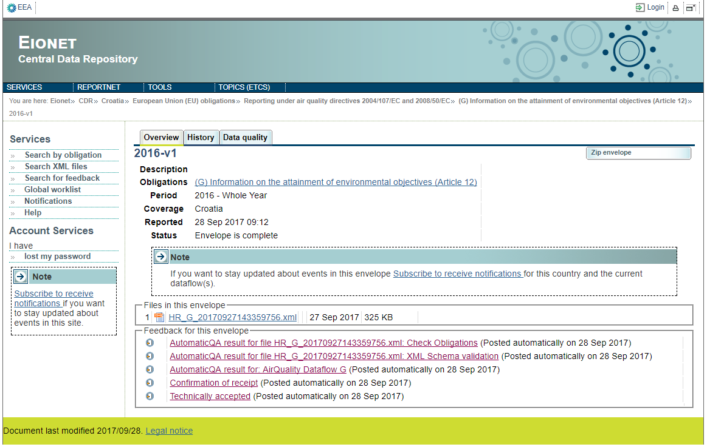
14.6 EIONET – CENTRAL DATA REPOSITORY
European Union IPA 2013 Programme for Croatia
Each folder contains:
- the obligation to report,
- the period for which is to be reported,
- the date when data was published,
- status (whether it's done and whether the data is available to the public or delivery is still in progress ....)
http://cdr.eionet.europa.eu/hr/eu/aqd/g/envwcubcw/
Institut za energetiku i zaštitu okoliša
Energy Research and Environmental Protection Institute

Slide 85
14.6 EIONET – CENTRAL DATA REPOSITORY
European Union IPA 2013 Programme for Croatia
Each folder contains
- .xml file with submitted data and date of delivery
http://cdr.eionet.europa.eu/hr/eu/aqd/g/envwcubcw/
Institut za energetiku i zaštitu okoliša
Energy Research and Environmental Protection Institute

Slide 86
14.6 EIONET – CENTRAL DATA REPOSITORY
European Union IPA 2013 Programme for Croatia
Each folder contains links to:
- Automatic QA checks that every.xml file has to pass
- Confirmation receipt of file from EEA
- Confirmation that the file is technically accepted
http://cdr.eionet.europa.eu/hr/eu/aqd/g/envwcubcw/
Institut za energetiku i zaštitu okoliša
Energy Research and Environmental Protection Institute

Slide 87
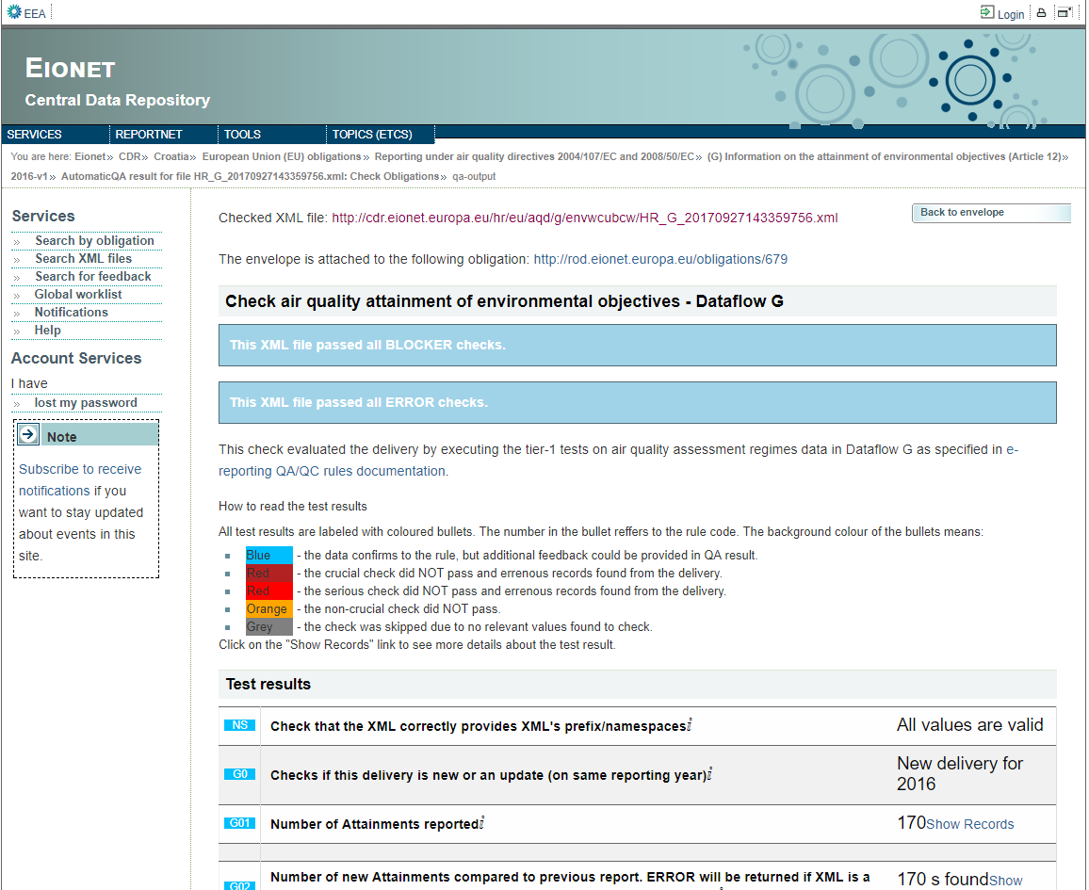
14.6 EIONET – CENTRAL DATA REPOSITORY
European Union IPA 2013 Programme for Croatia
QA checks - every.xml files has to pass QA checks:
If there are BLOCKERs – file shall not be accepted...
If there are ERRORs– file shall be accepted but the reason for ERROR has to be explained...
http://cdr.eionet.europa.eu/hr/eu/aqd/g/envwcubcw/AutomaticQA_418322/qa-output/view
Institut za energetiku i zaštitu okoliša
Energy Research and Environmental Protection Institute

Slide 88
14.6 EIONET – CENTRAL DATA REPOSITORY
European Union IPA 2013 Programme for Croatia
Result interpretation of QA check:
Blue – dana go through QA checks
Dark red- key test not passed= BLOCKER – file not accepted.
Red – serius check would not pass
= ERROR – file shall be accepted but the reason for ERROR has to be explained.
Orange – non-key test not passed – clarification and check are required subsequently
Grey – test was skipped due to unavailable data
http://cdr.eionet.europa.eu/hr/eu/aqd/g/envwcubcw/AutomaticQA_418322/qa-output/view
Institut za energetiku i zaštitu okoliša
Energy Research and Environmental Protection Institute

Slide 89
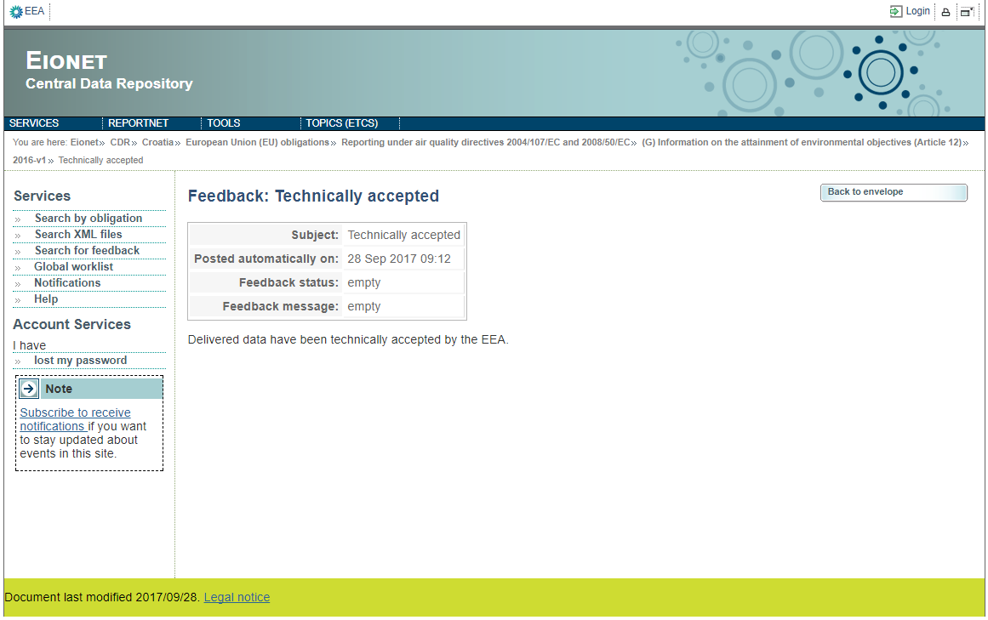
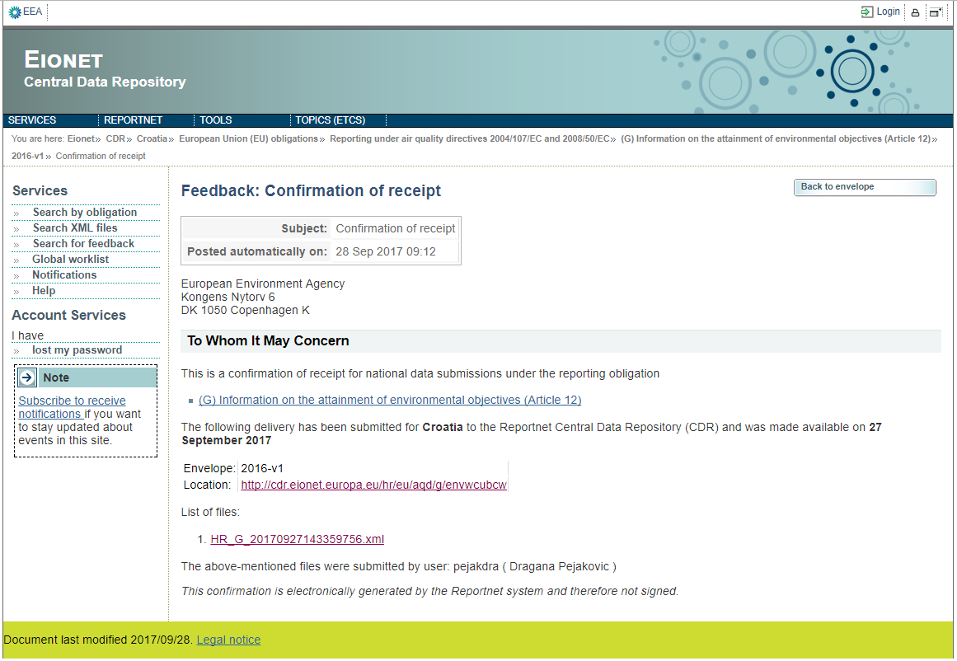
14.6 EIONET – CENTRAL DATA REPOSITORY
European Union IPA 2013 Programme for Croatia
Feedback of receipt confirmation and confirmation that the file is technically accepted is obtained only after the .xml file has passed all QA checks
http://cdr.eionet.europa.eu/hr/eu/aqd/g/envwcubcw/feedback1506515723
http://cdr.eionet.europa.eu/hr/eu/aqd/g/envwcubcw/feedbackTA
Institut za energetiku i zaštitu okoliša
Energy Research and Environmental Protection Institute

Slide 90
THANK YOU FOR YOUR ATTENTION
Energy Research and Environmental Protection Institute
Disclaimer: The contents of this publication are the sole responsibility of EKONERG – Energy Research and Environmental Protection Institute, Ltd. and can in no way be taken to reflect the views of the European Union
This project is funded by the European Union

